Slide 1



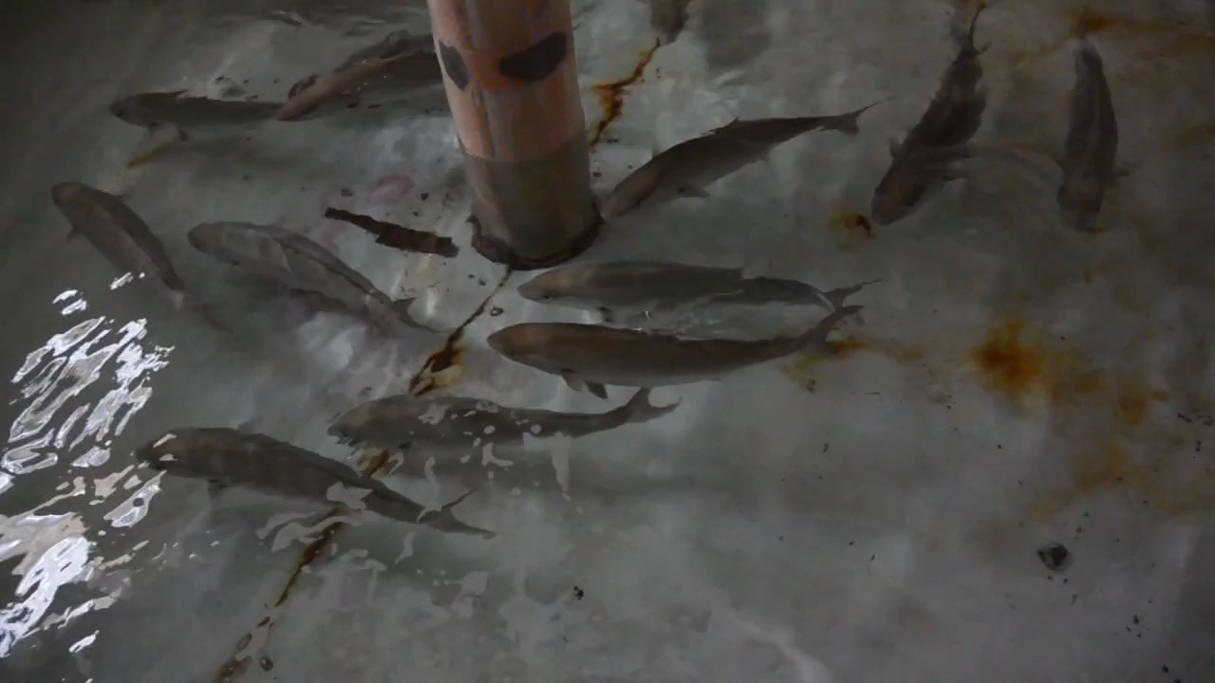
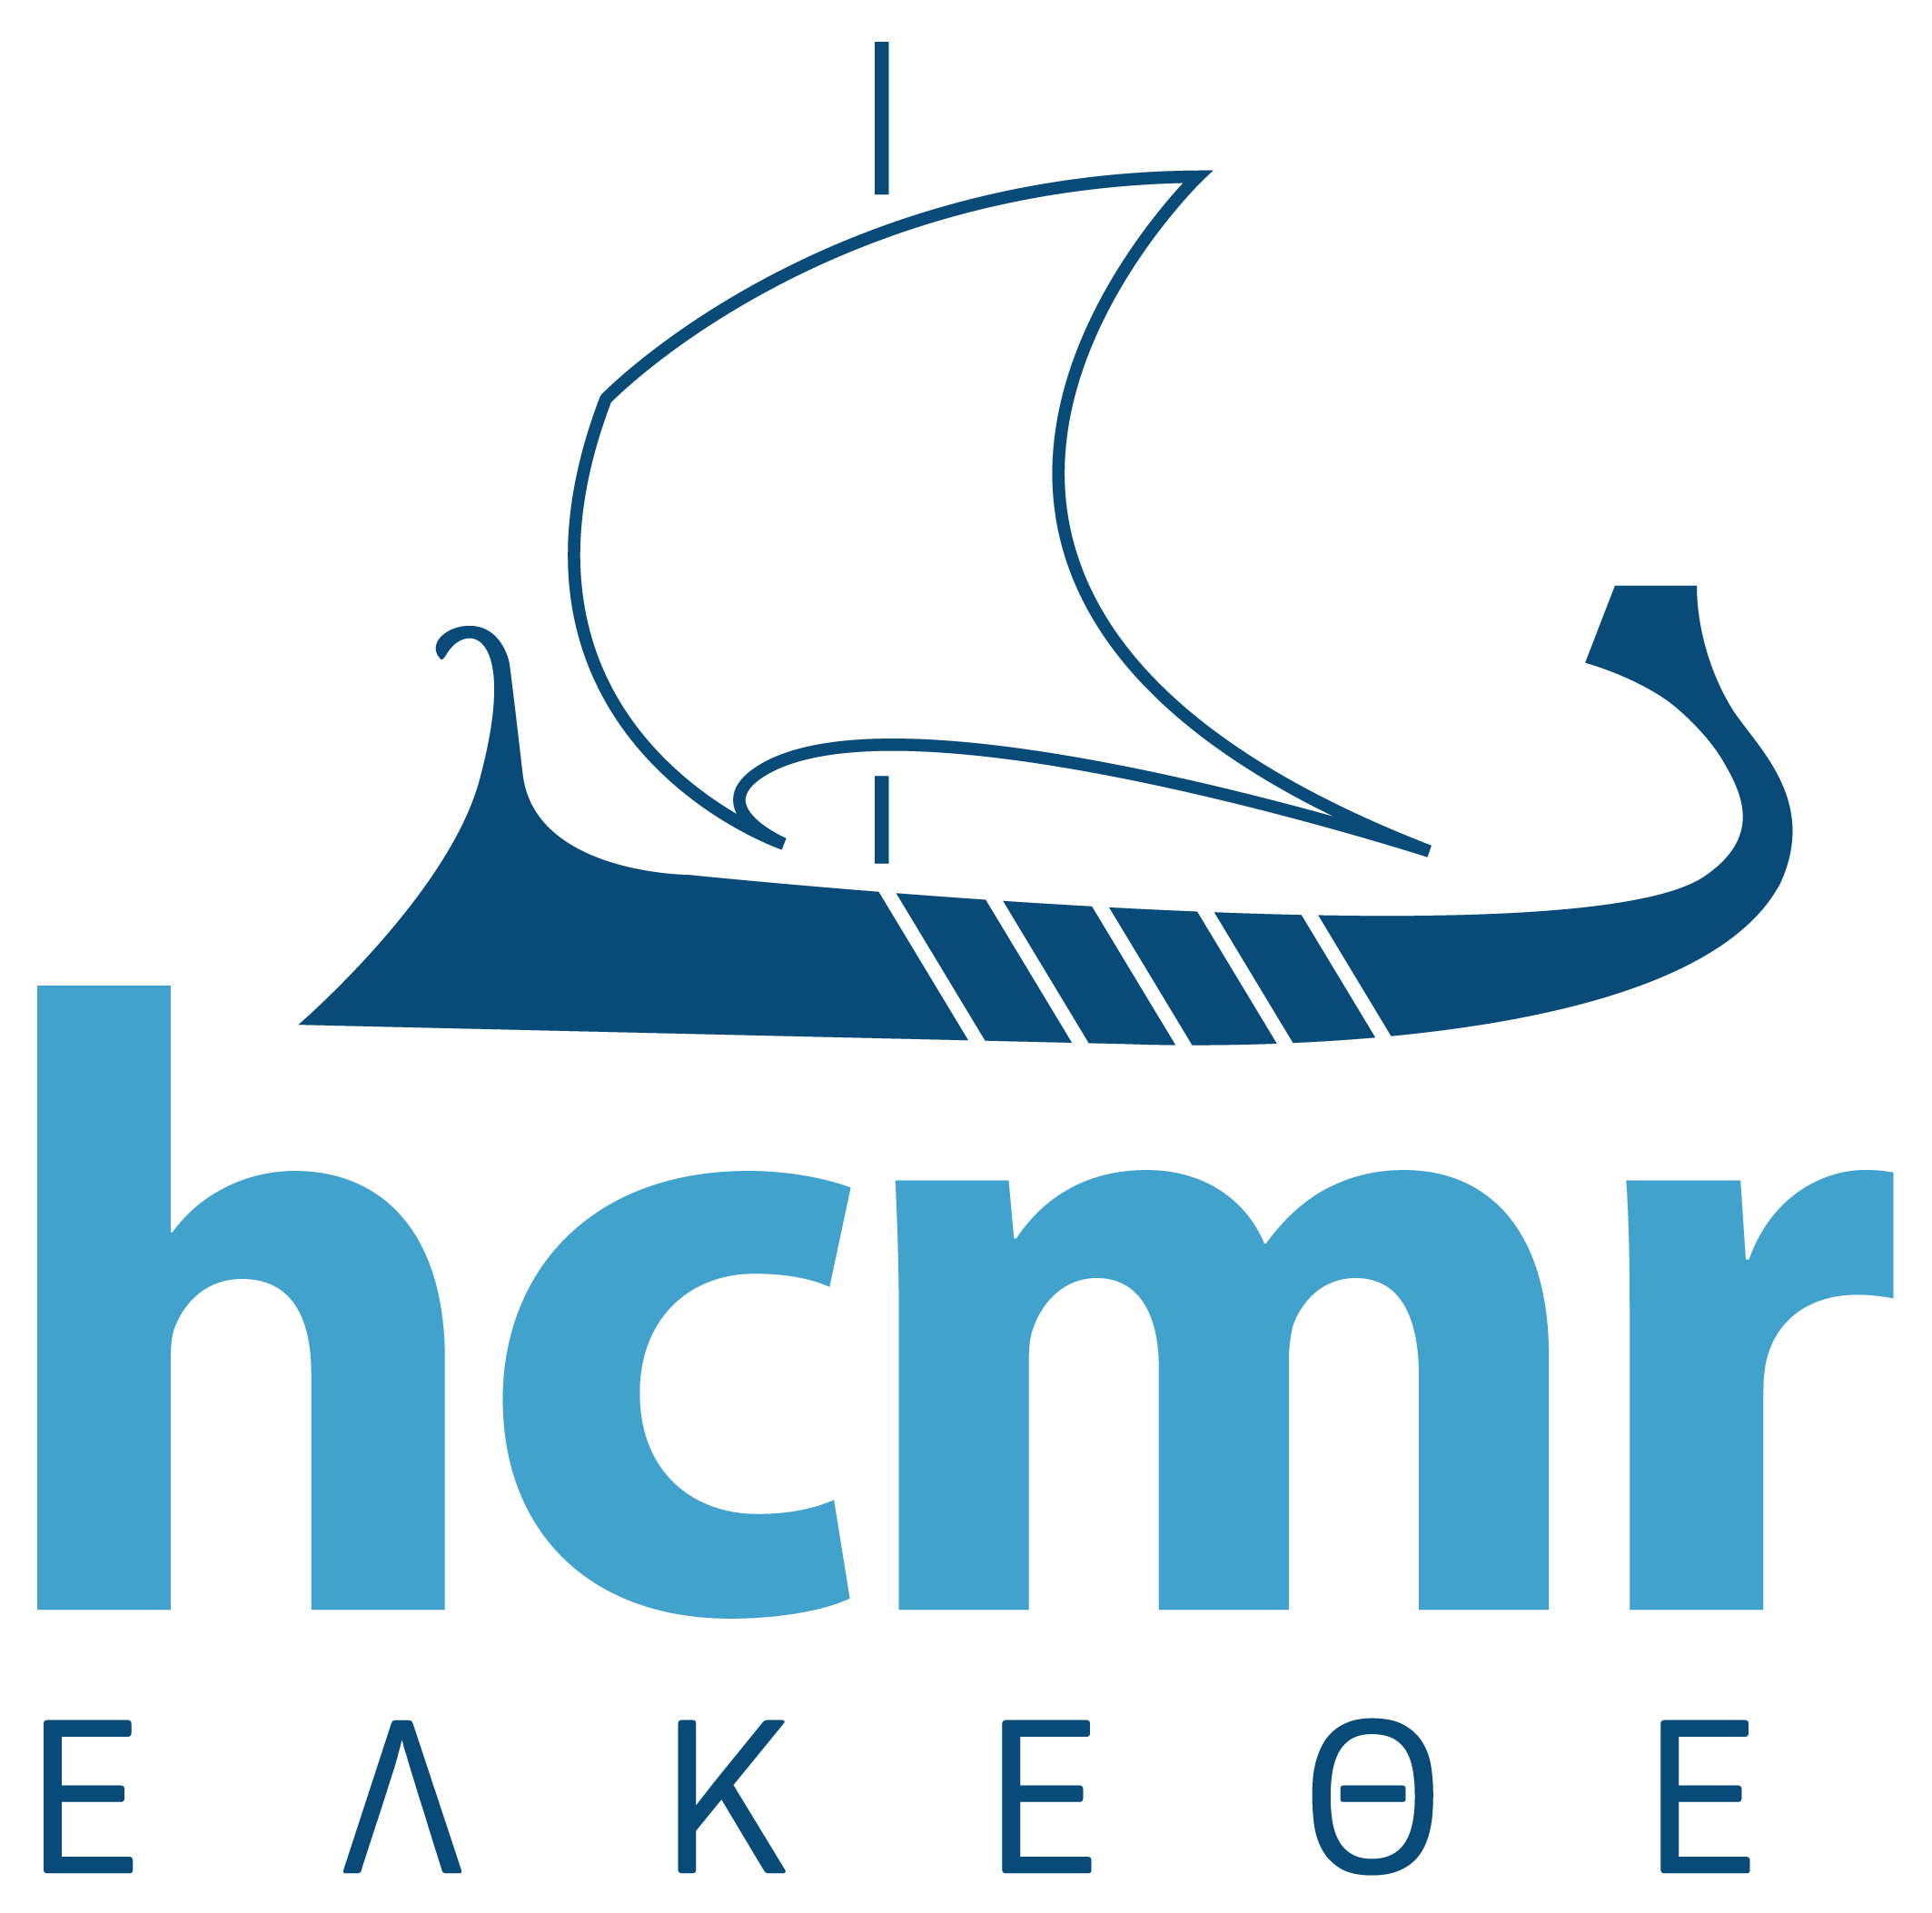
Diversification Session
Exploring the biological and socioeconomic potential of new/emerging candidate fish species for the expansion of the European aquaculture industry
Co-funded by the Seventh Framework Programme
of the European Union
Constantinos C Mylonas
Hellenic Center for Marine Research
Crete, Greece

Slide 2
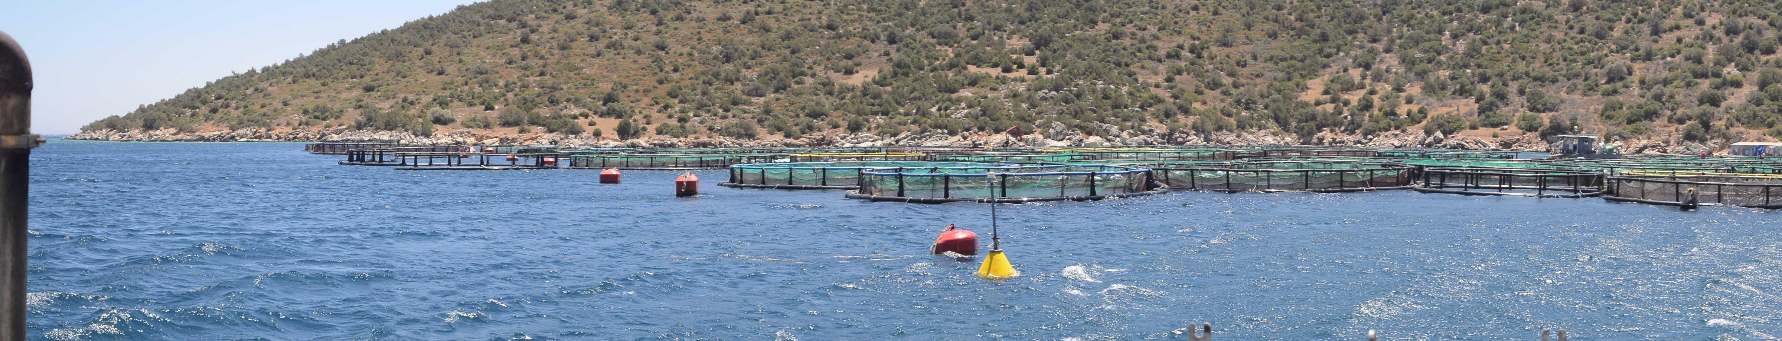
KBBE-2013-07-GA 603121 DIVERSIFY
Duration = 5 years (2014-2018)
Budget = €11,8 million
Largest Aquaculture research project funded by the European Commission to date
Institute of Marine Biology, Biotechnology and Aquaculture, Crete (HCMR) coordinator

Slide 3
Objectives of DIVERSIFY
Enhancing the European Union aquaculture production by removing production bottlenecks of new/emerging species, producing new products and developing new markets

Slide 4
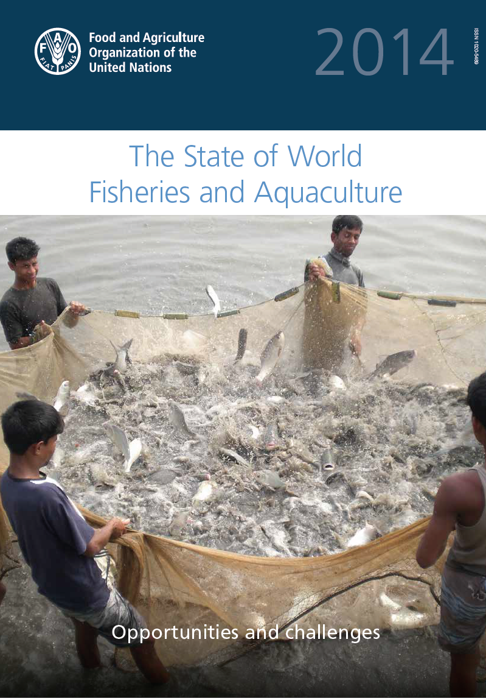
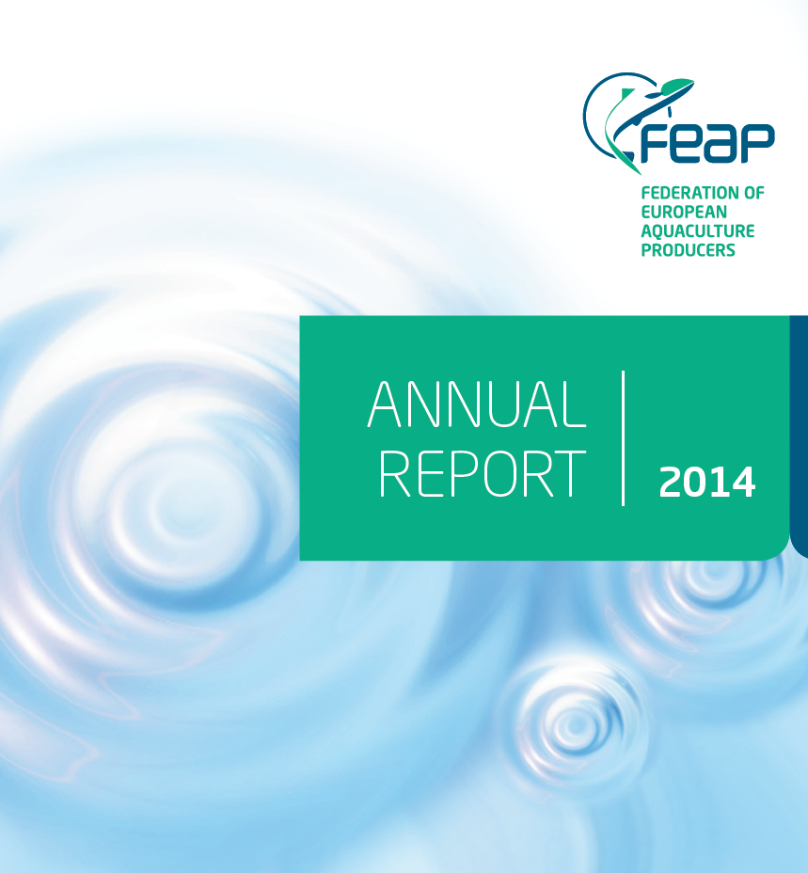
Seafood consumption in the world/EU
50% of seafood worldwide from Aquaculture (vs wild Fisheries)
10% of seafood in the EU from Aquaculture
65% of seafood in the EU imported!!!!
Strong interest by the European Commission to increase EU aquaculture production

Slide 5
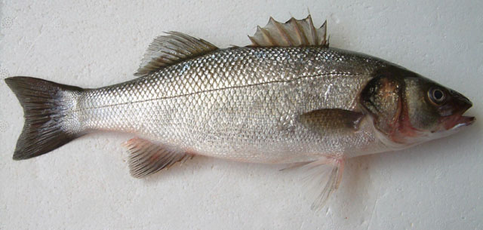
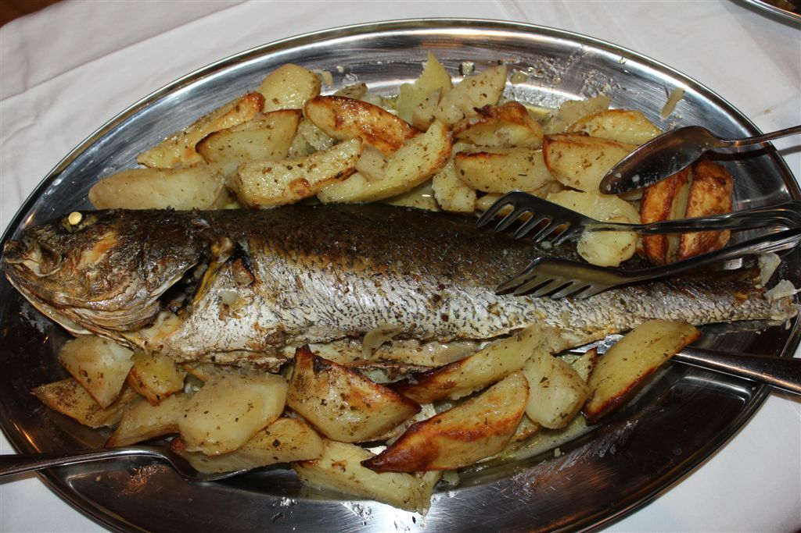
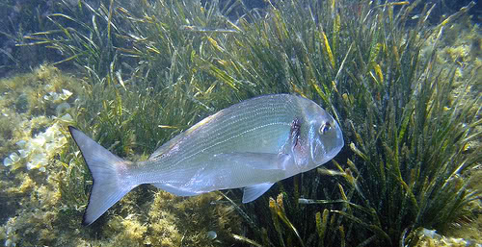
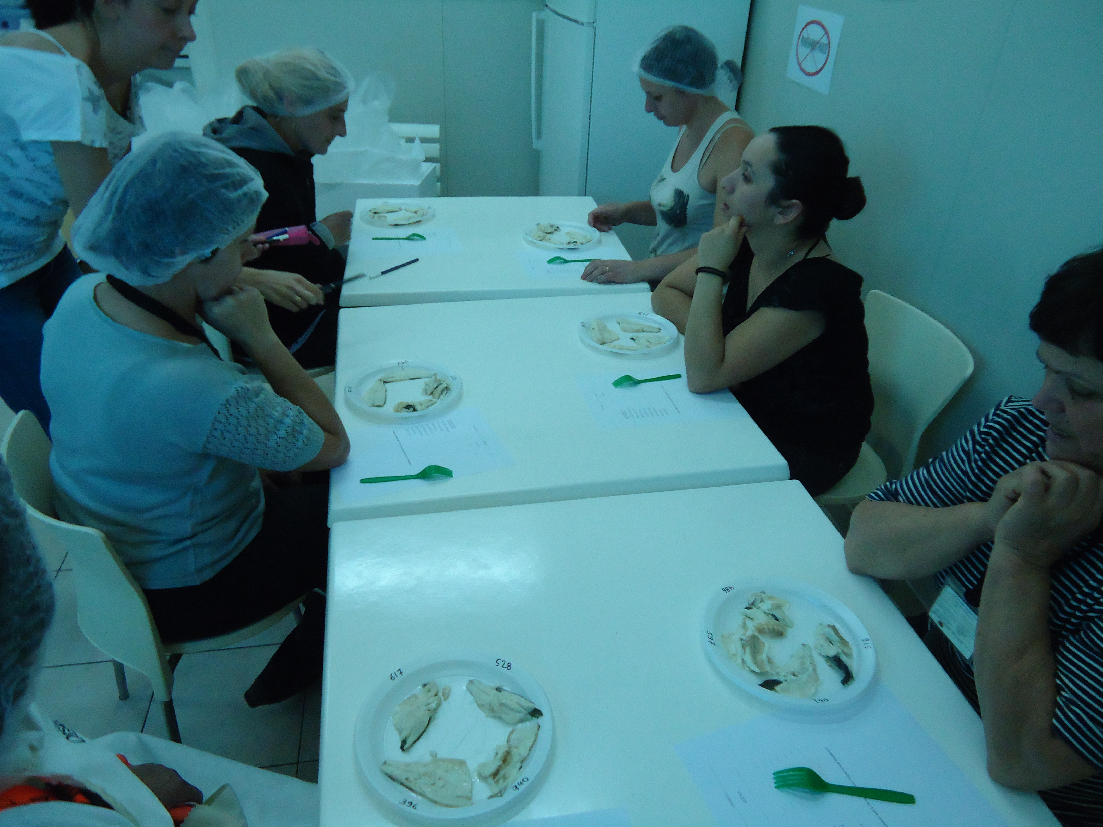
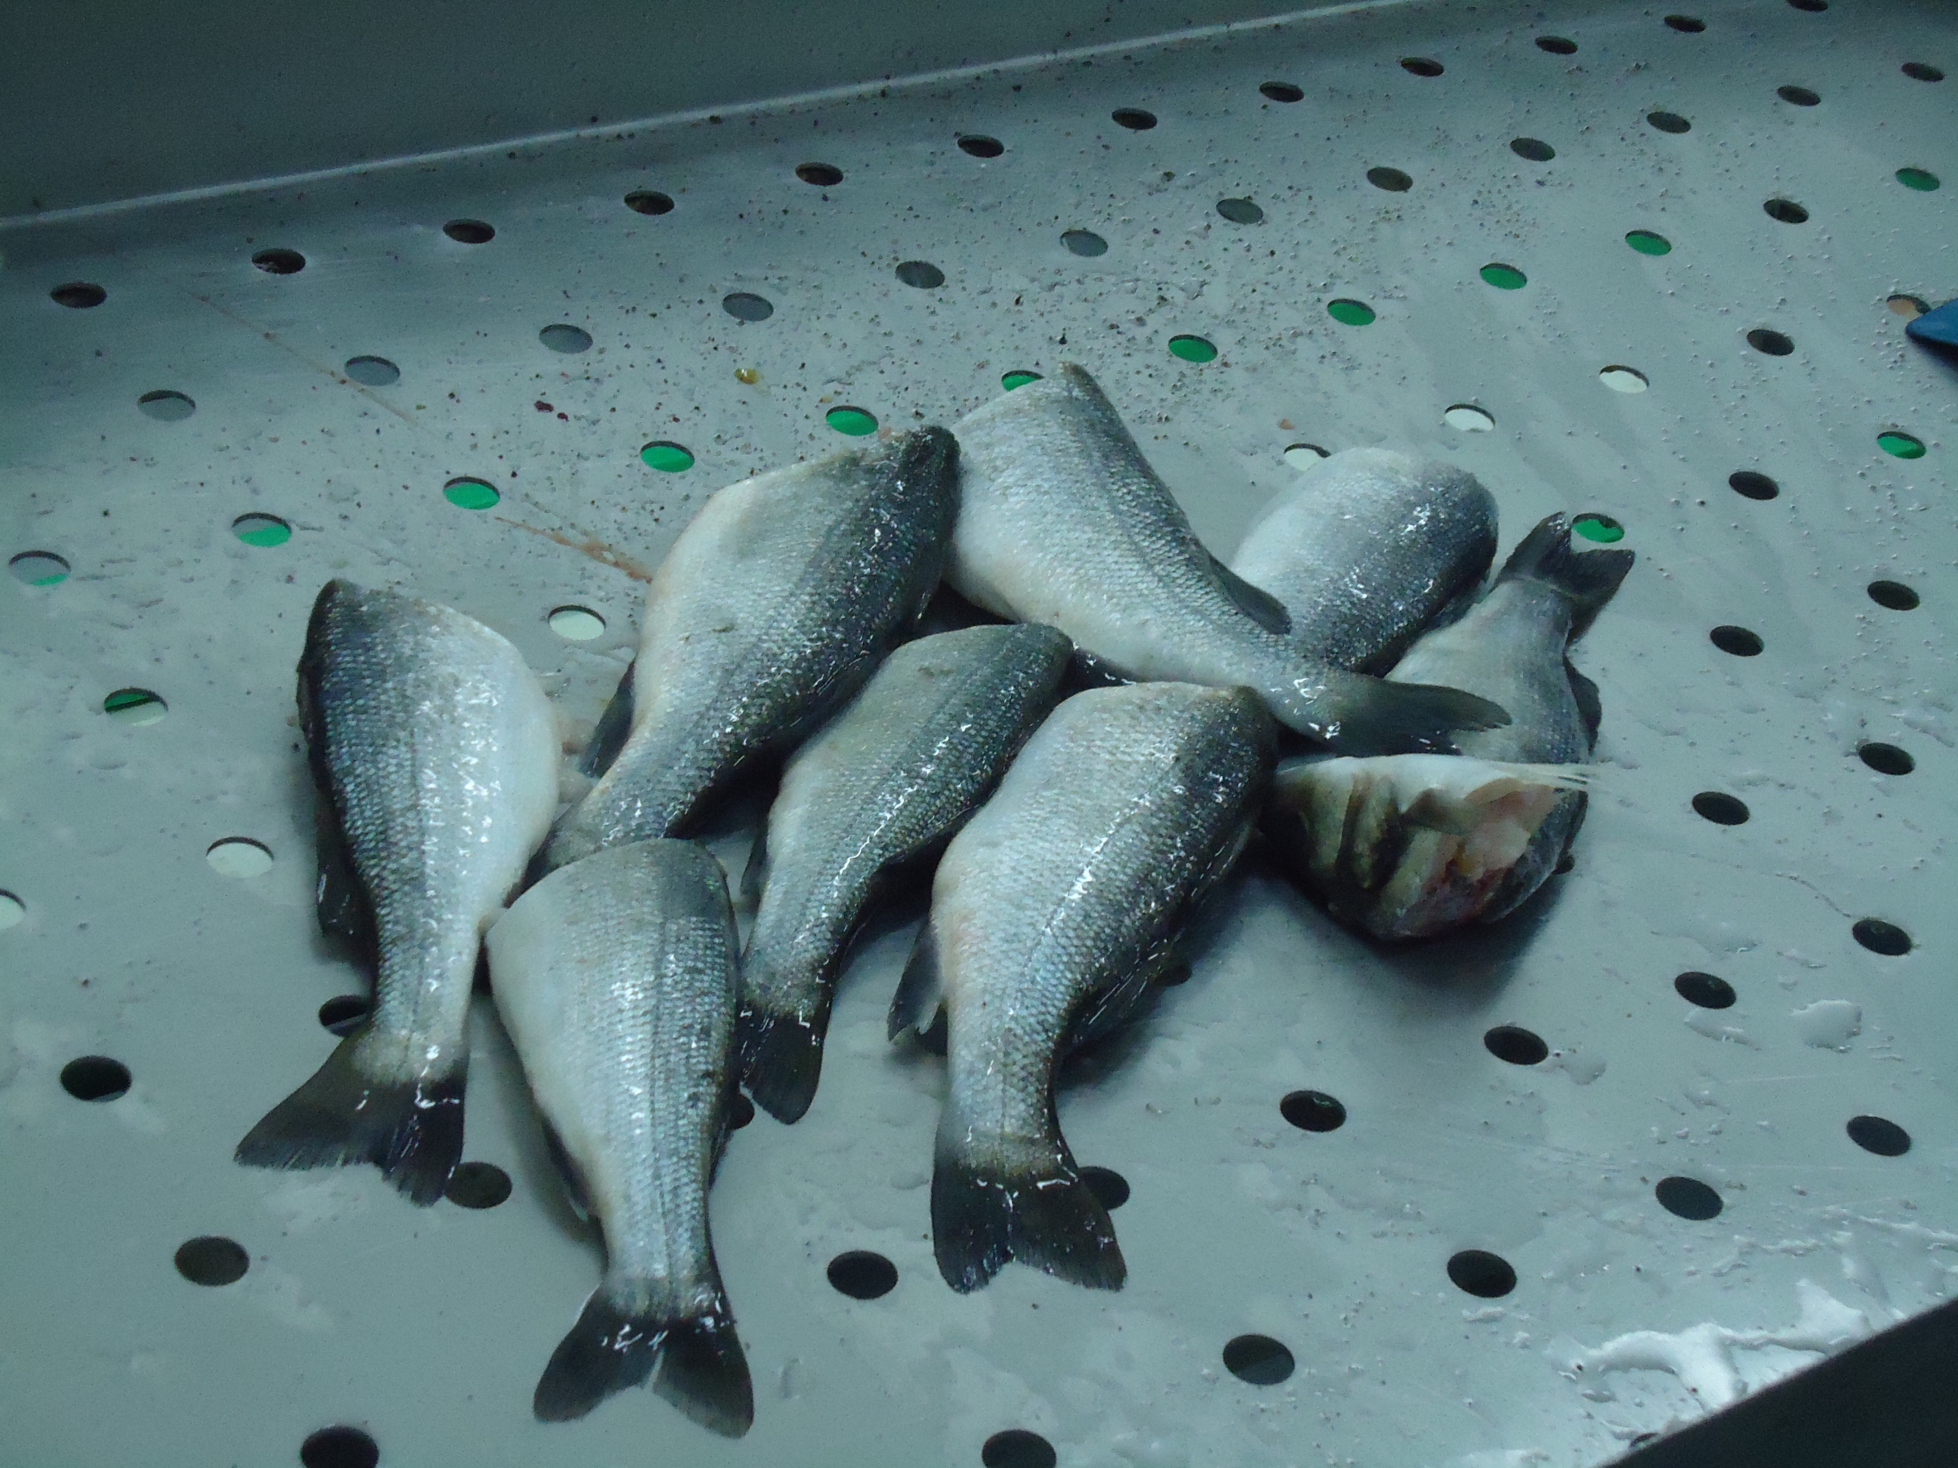
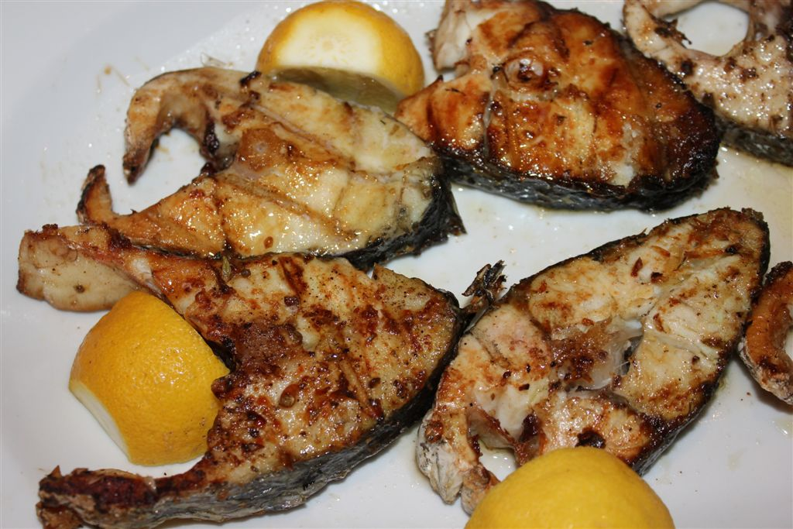
Problems with Mediterranean species
Consumers prefer fillets, steaks, ready-to-cook
Small, plate size (difficult to prepare, bones)
Larger fish more expensive to grow (3 y !!!!)

Slide 6
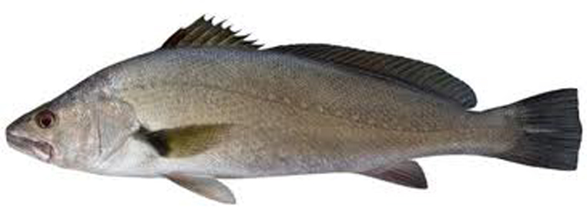
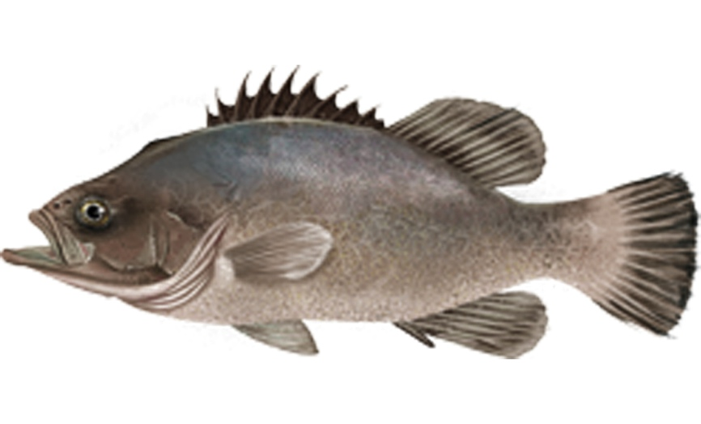
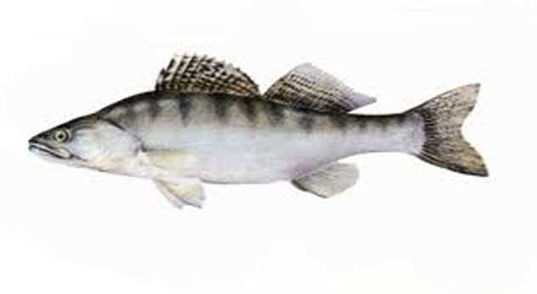
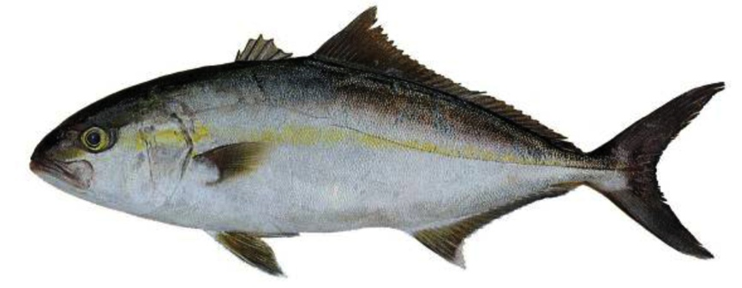
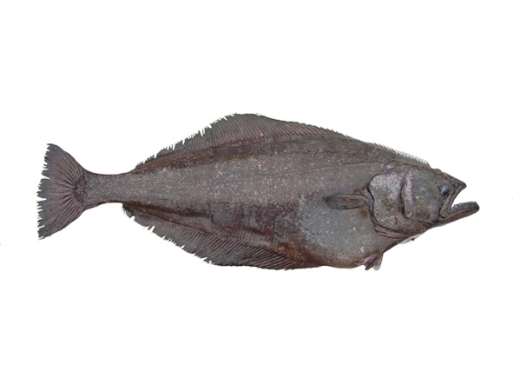
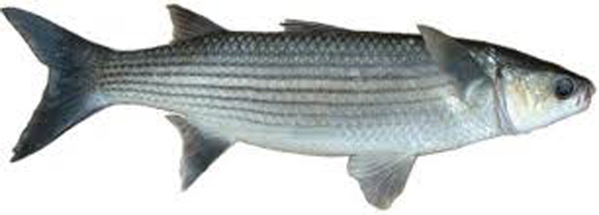
Choice of new/emerging species
meagre 23% (warm water, marine)
greater amberjack 31% (warm water, marine)
wreckfish 7% (cool water, marine)
Atlantic halibut 13% (cold water, marine)
grey mullet 11% (warm water, marine, herbivorous)
pikeperch 14% (fresh water, RAS)
meagre
(Argyrosomus regius)
pike perch
(Sander lucioperca)
Grey mullet
(Mugil cephalus)
wreckfish
(Polyprion americanus)
greater amberjack
(Seriola dumerili)
Atlantic halibut
(Hippoglossus hippoglossus)

Slide 7
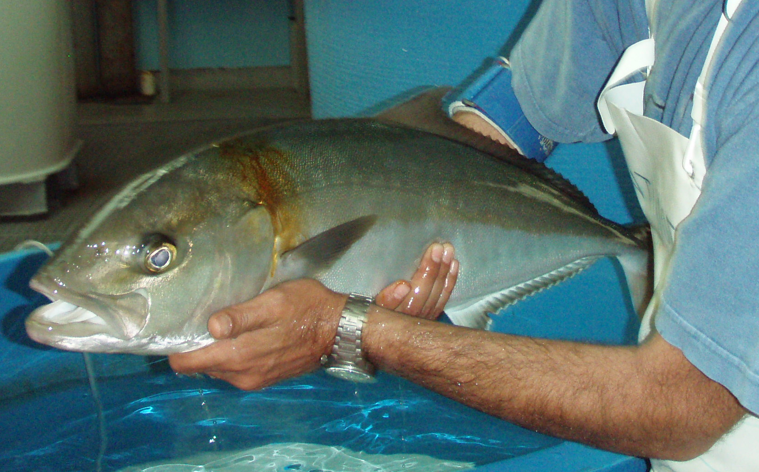
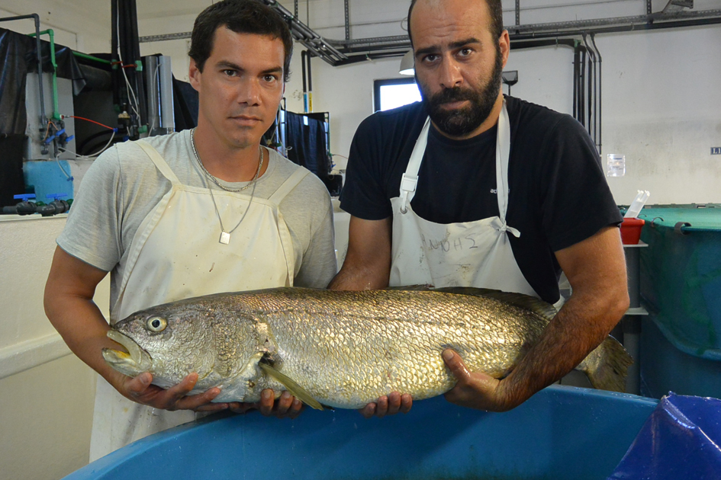
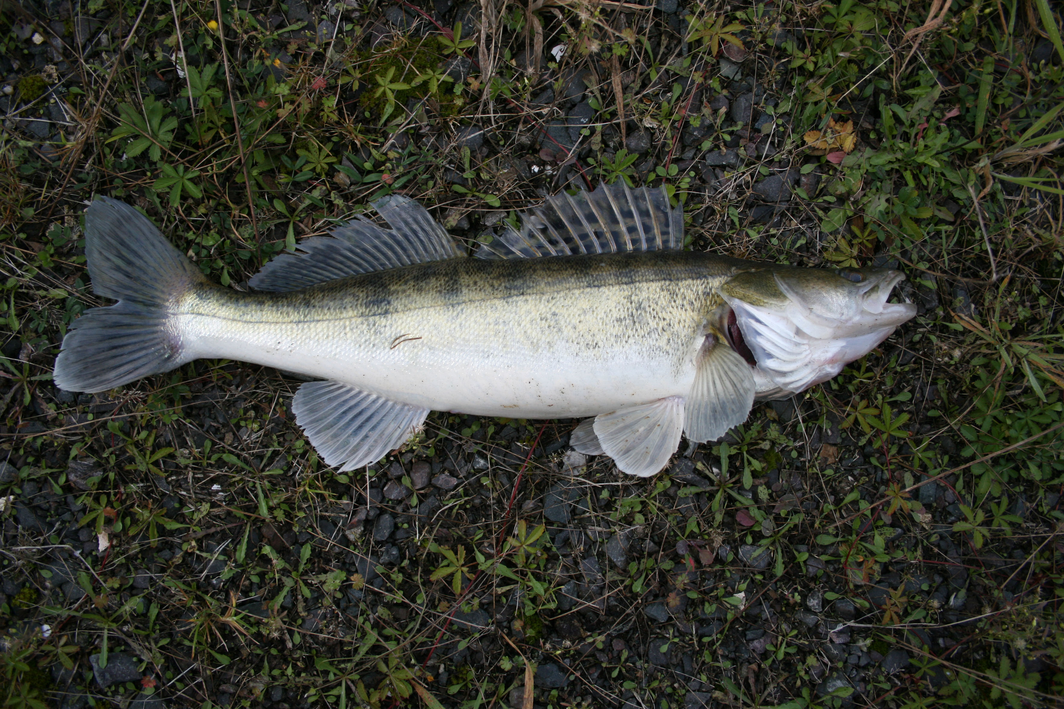
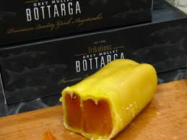
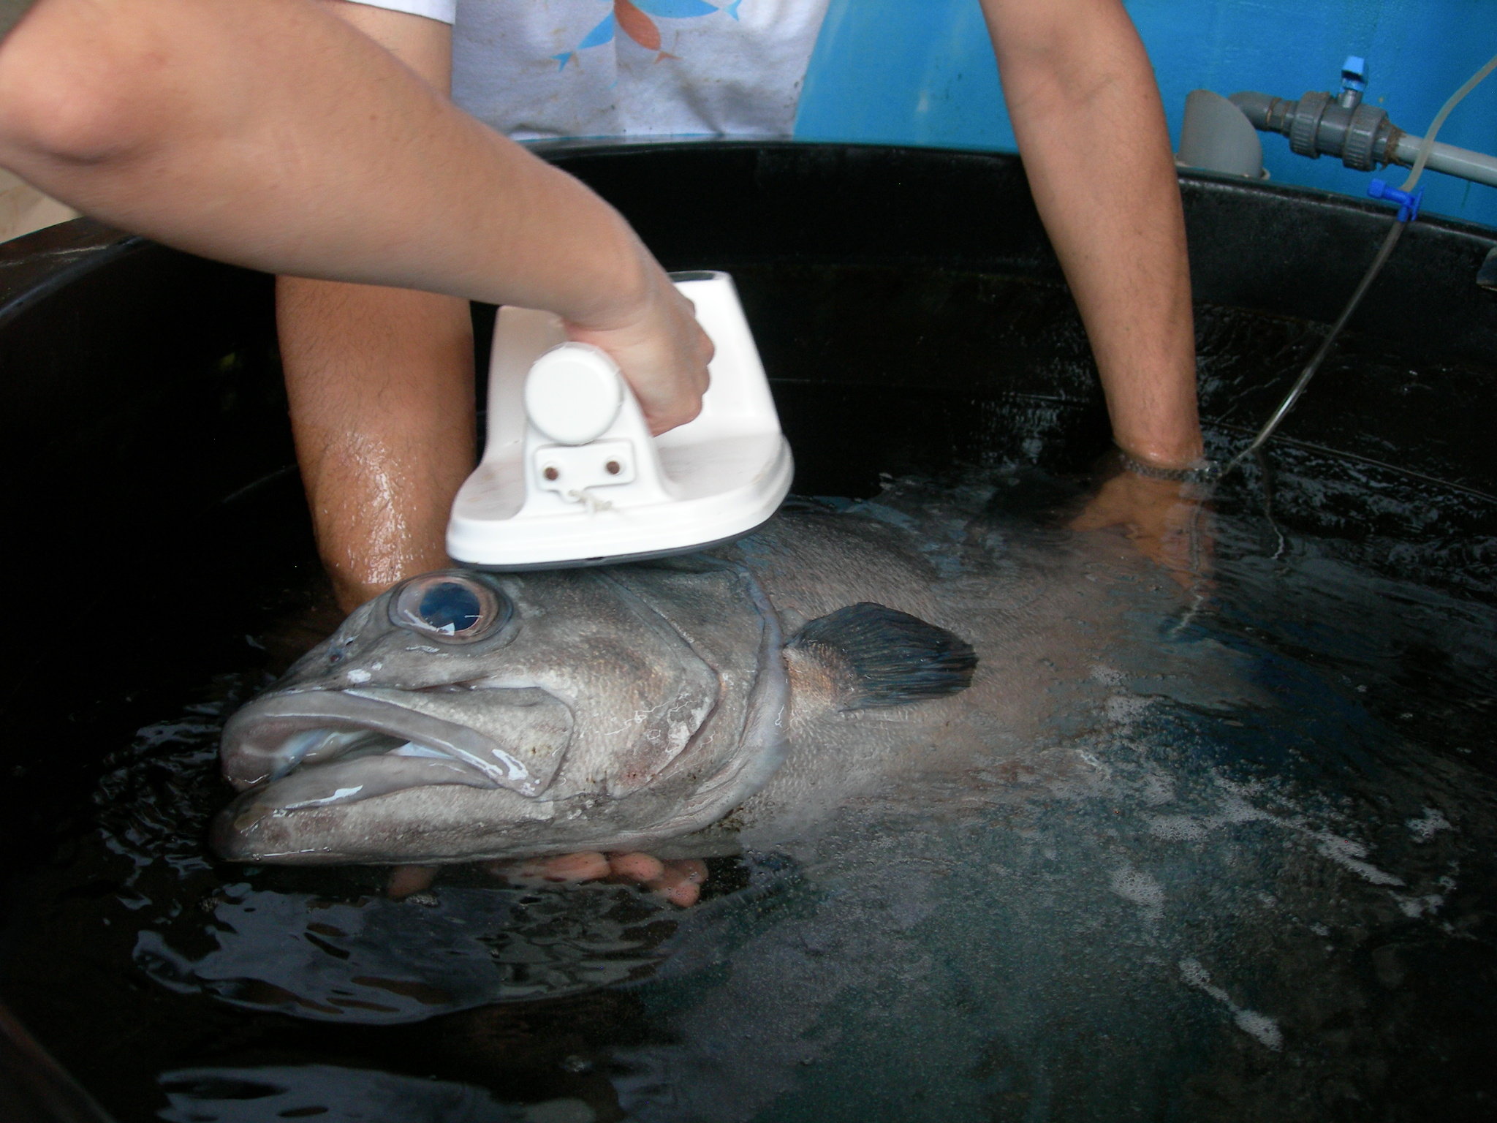
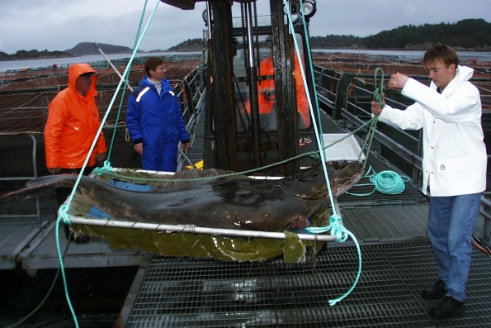
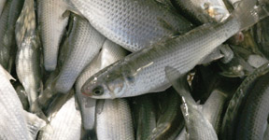
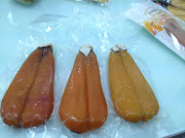
Choice of new/emerging species
greater amberjack
Pikeperch (fw, RAS)
meagre
grey mullet
(herbivorous, extensive)
Atlantic halibut
wreckfish

Slide 8
Bottlenecks of new/emerging species
meagre (variable growth, limited genetic variation, nutrition, health)
greater amberjack (reproduction, juvenile production, parasites)
wreckfish (broostock availability, reproduction, juvenile production)
Atlantic halibut (reproduction, juvenile production, health)
grey mullet (reproduction, larval rearing, nutrition)
pikeperch (juvenile production )

Slide 9
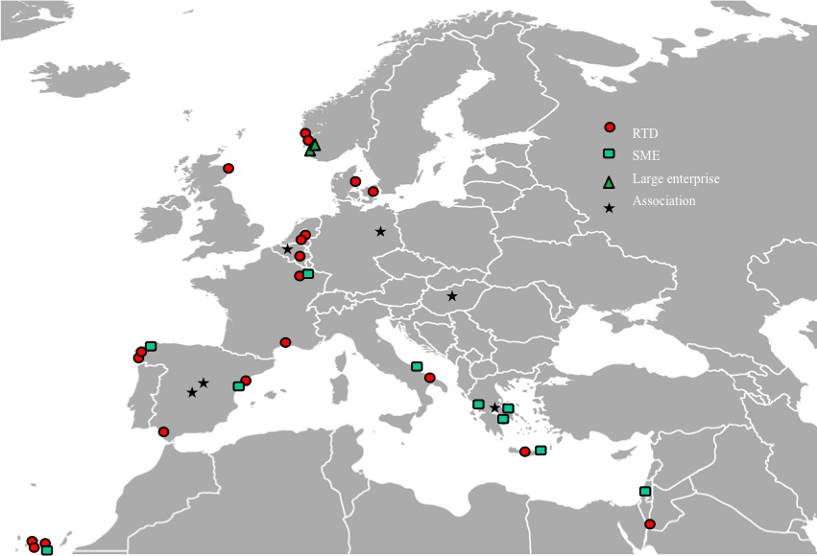
Partnership of DIVERSIFY
38 partners:
Spain, France, Italy, Greece, Israel, Belgium, Denmark, Netherlands, Norway, UK, Germany and Hungary
20 Research/Universities
9 Small Medium Enterprises
3 Large companies
5 Professional associations
1 NGO

Slide 10
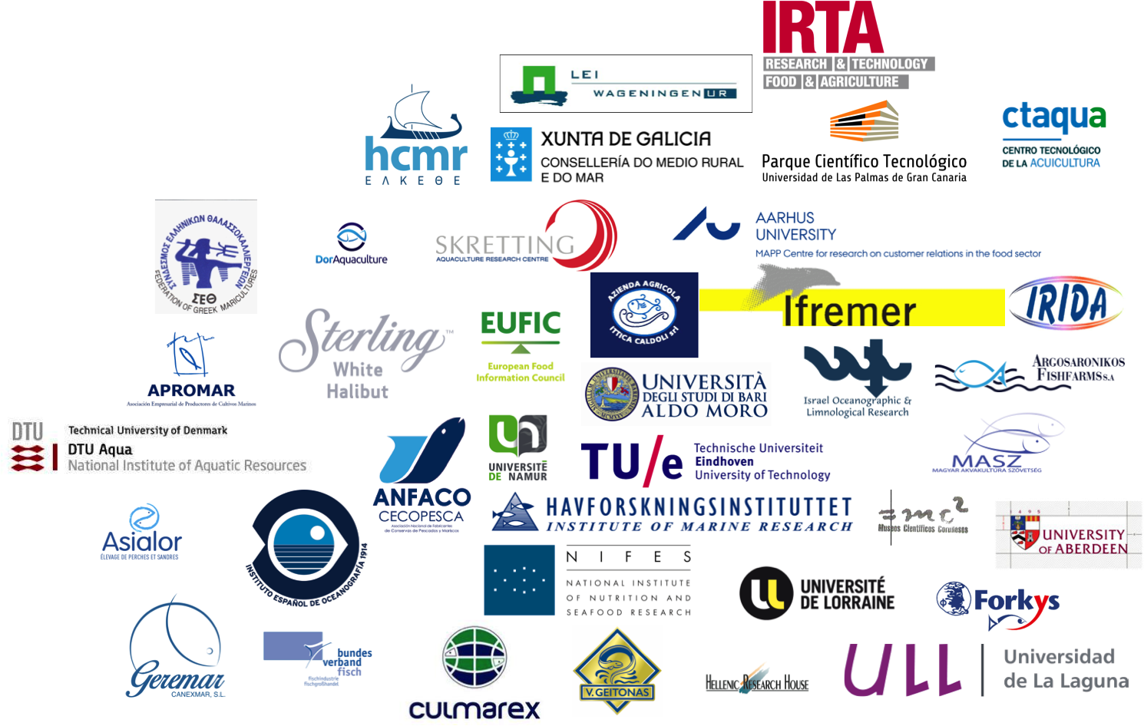
Partnership of DIVERSIFY
38 partners:

Slide 11
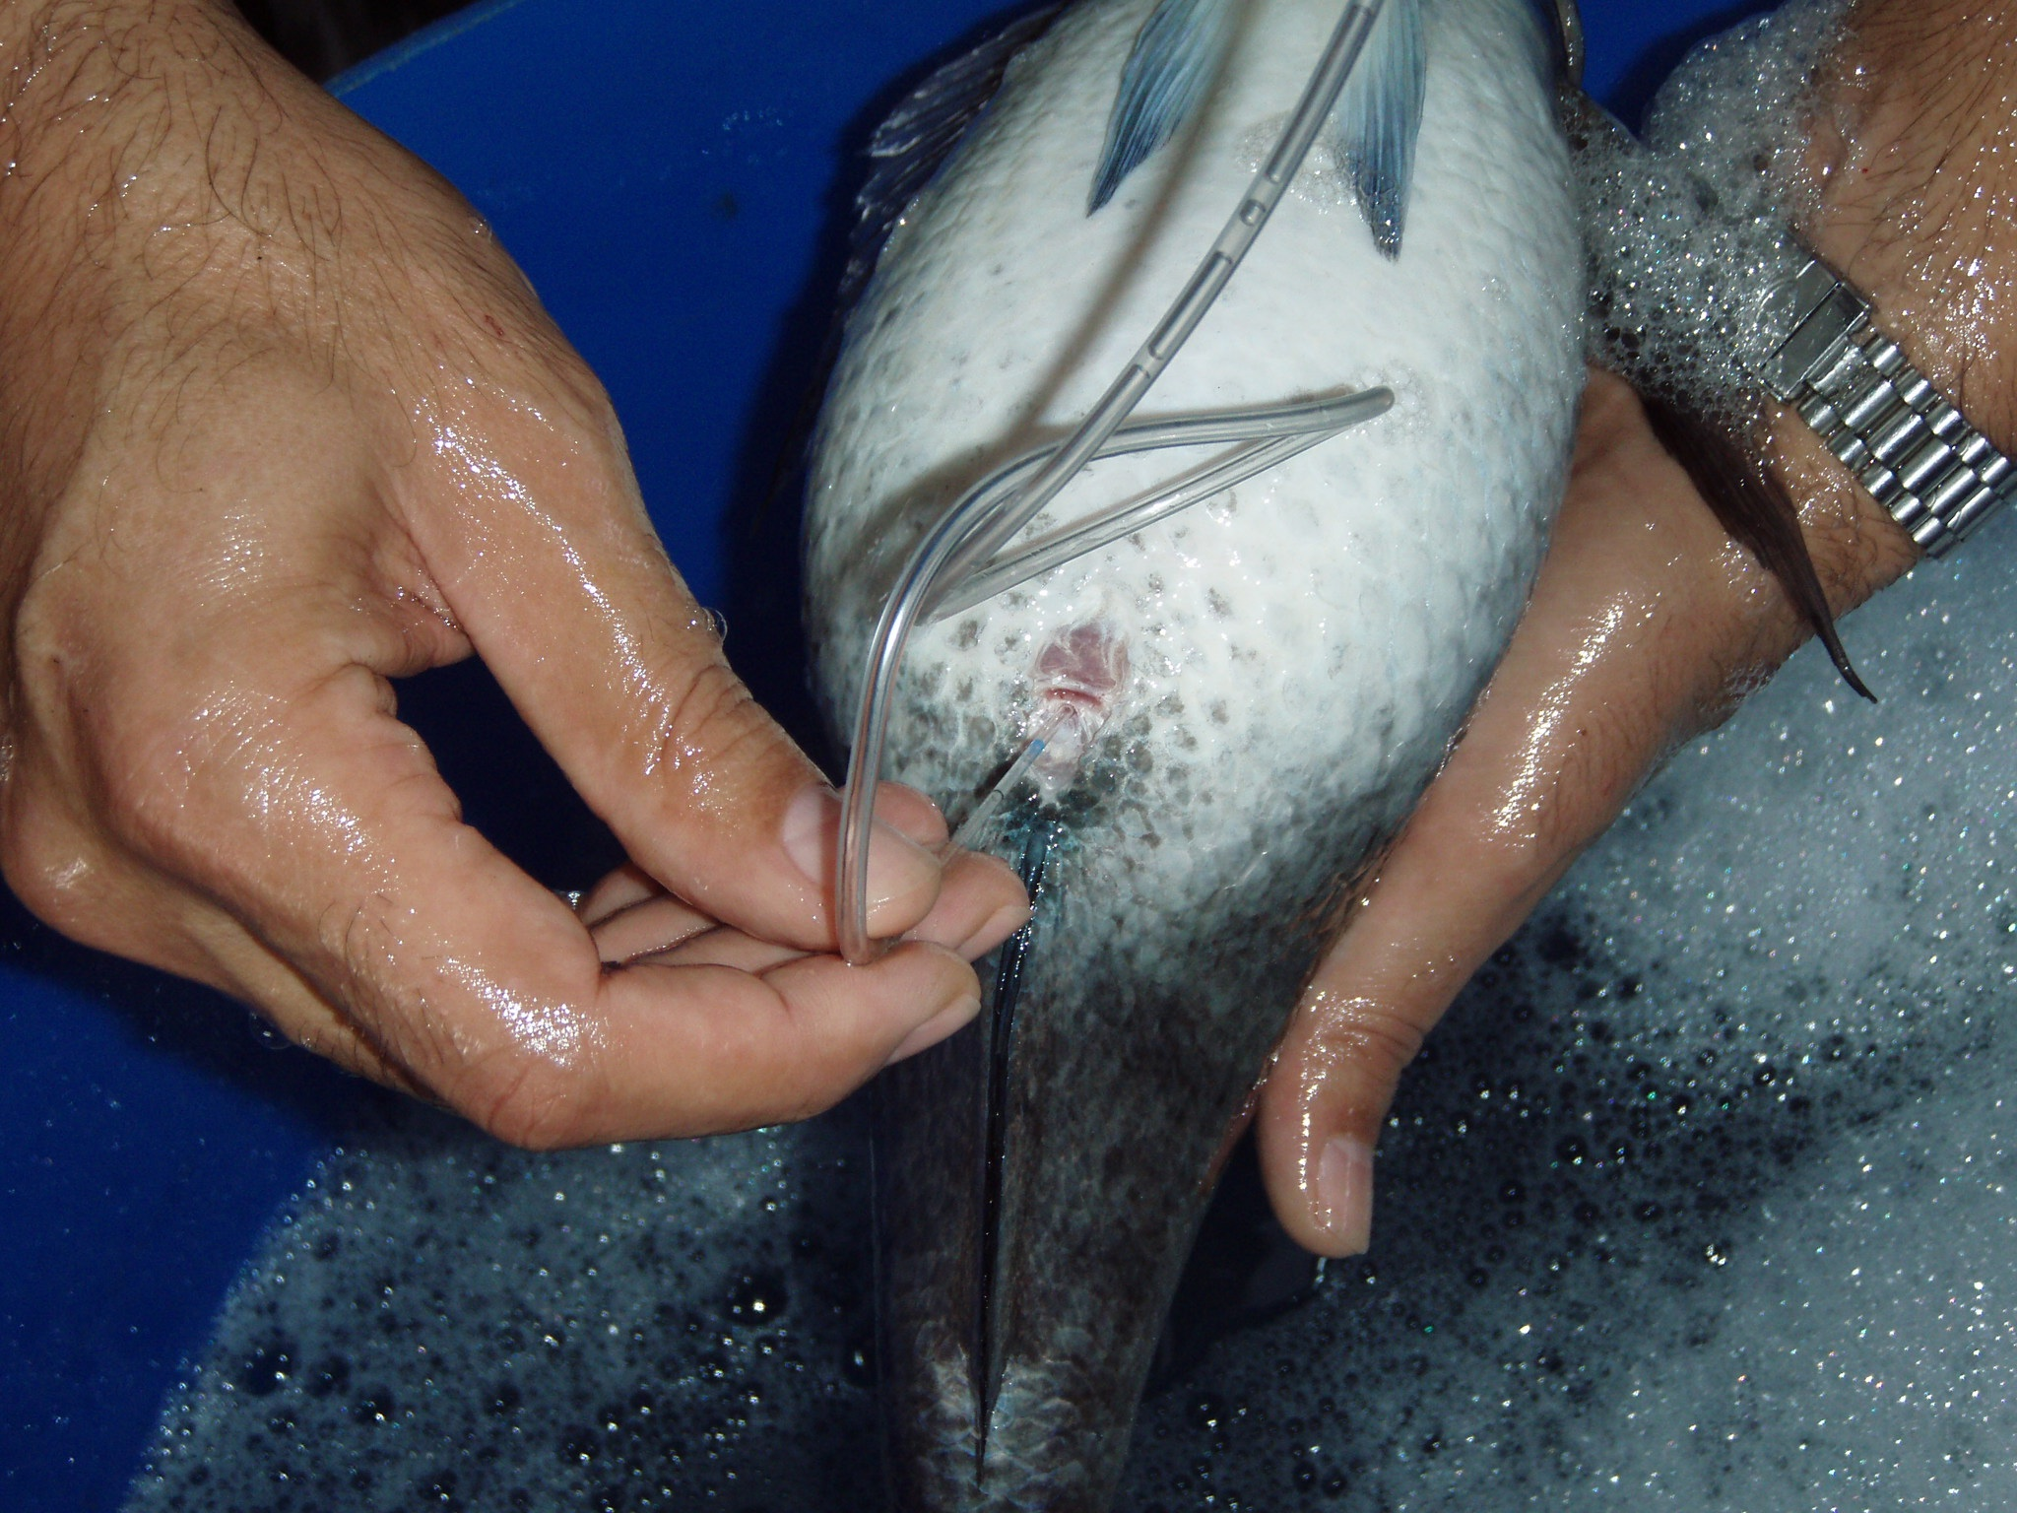
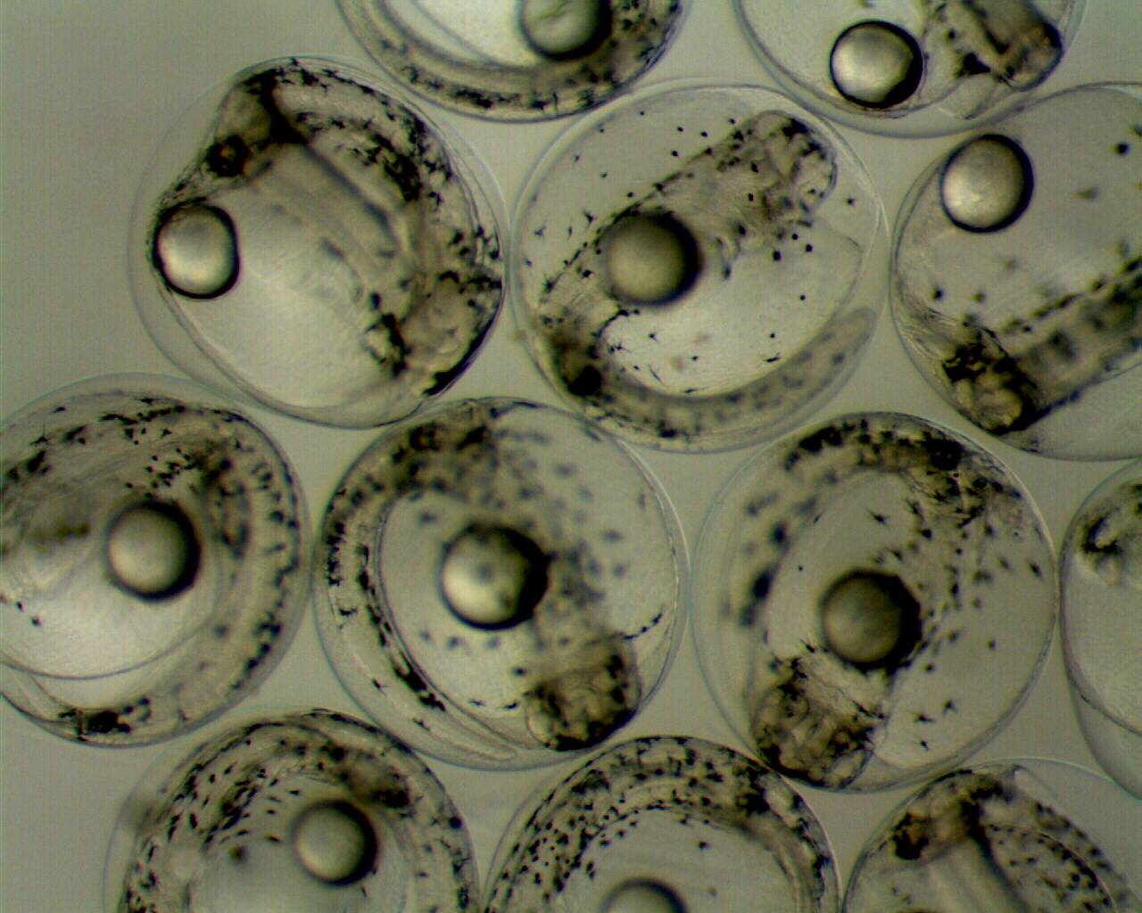
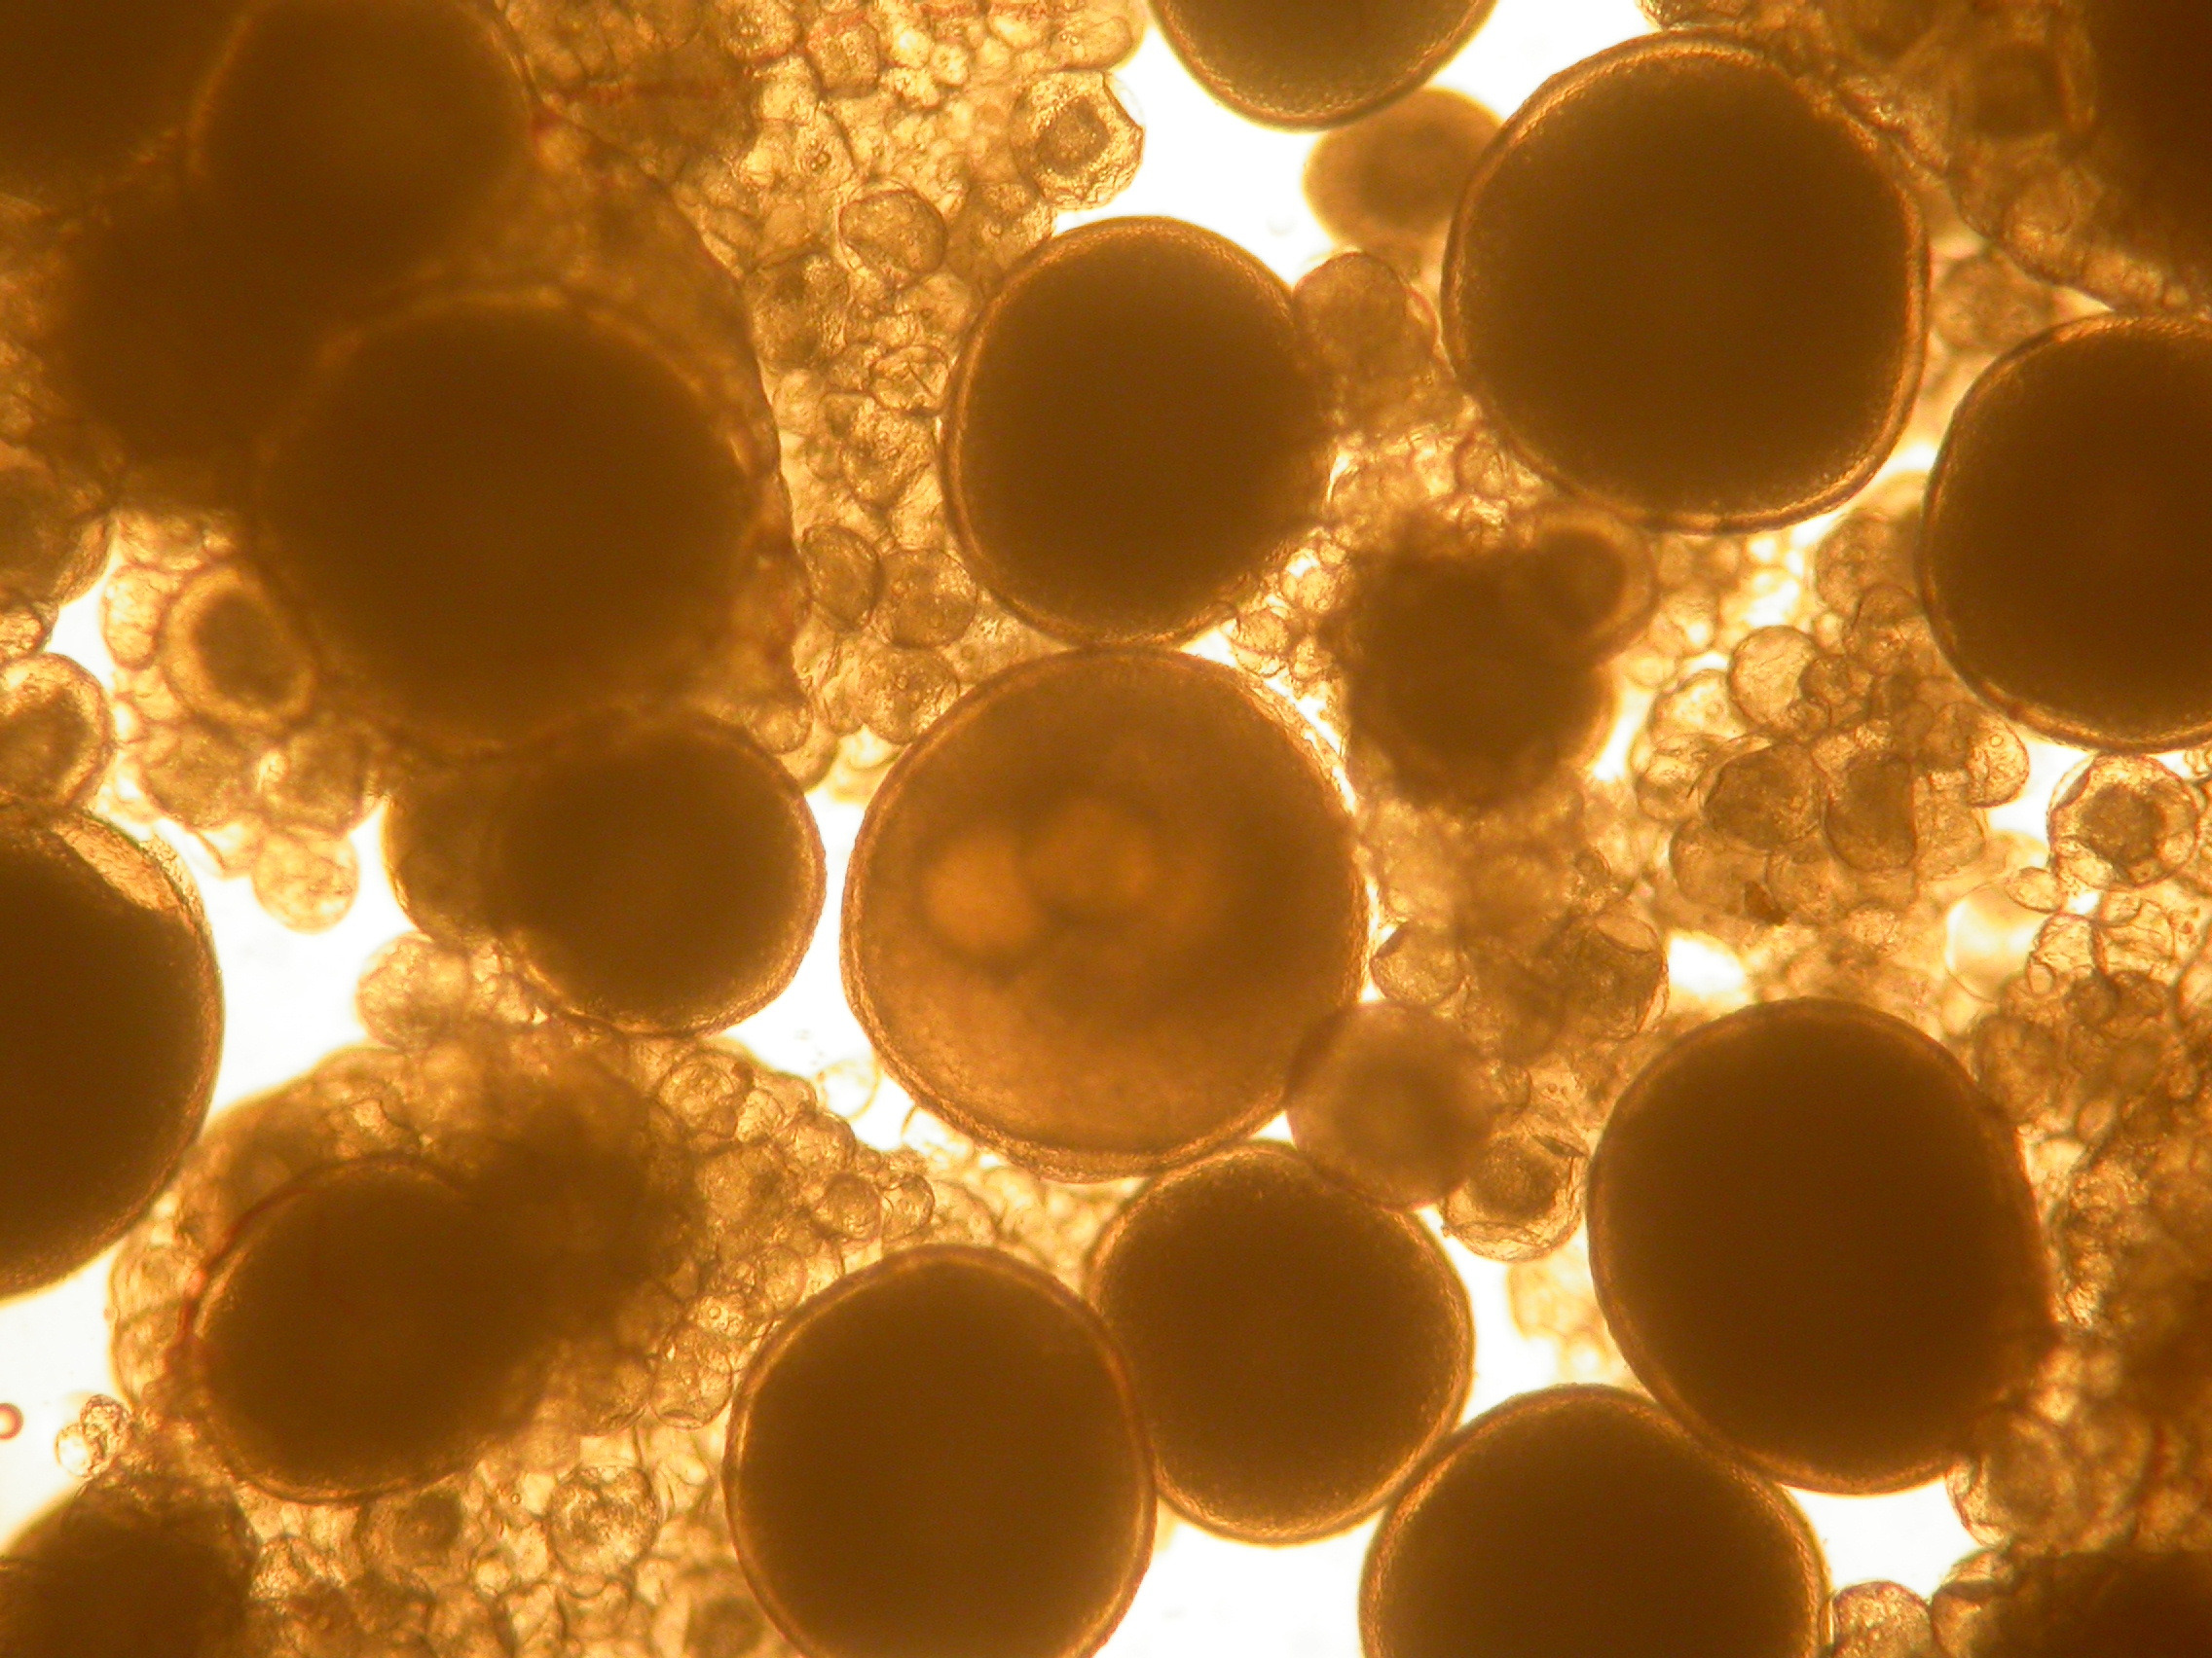
Scientific disciplines 1/6
Reproduction & Genetics (21%)
  Study reproductive cycle
  Develop spawning induction methods
  Genetics tools for selective breeding

Slide 12
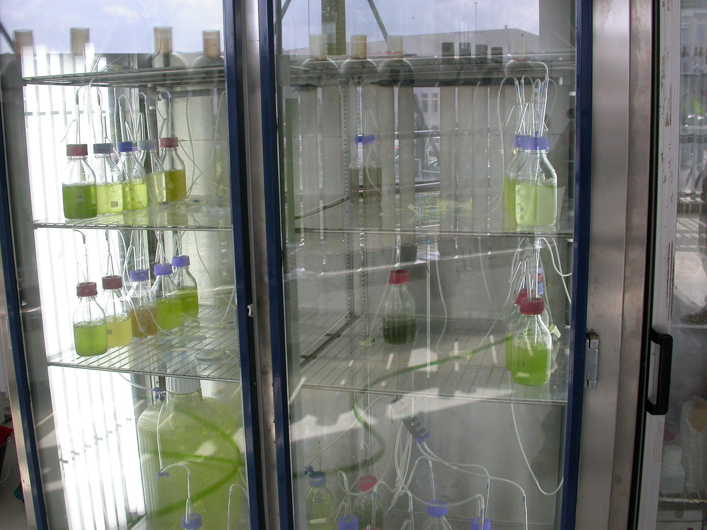
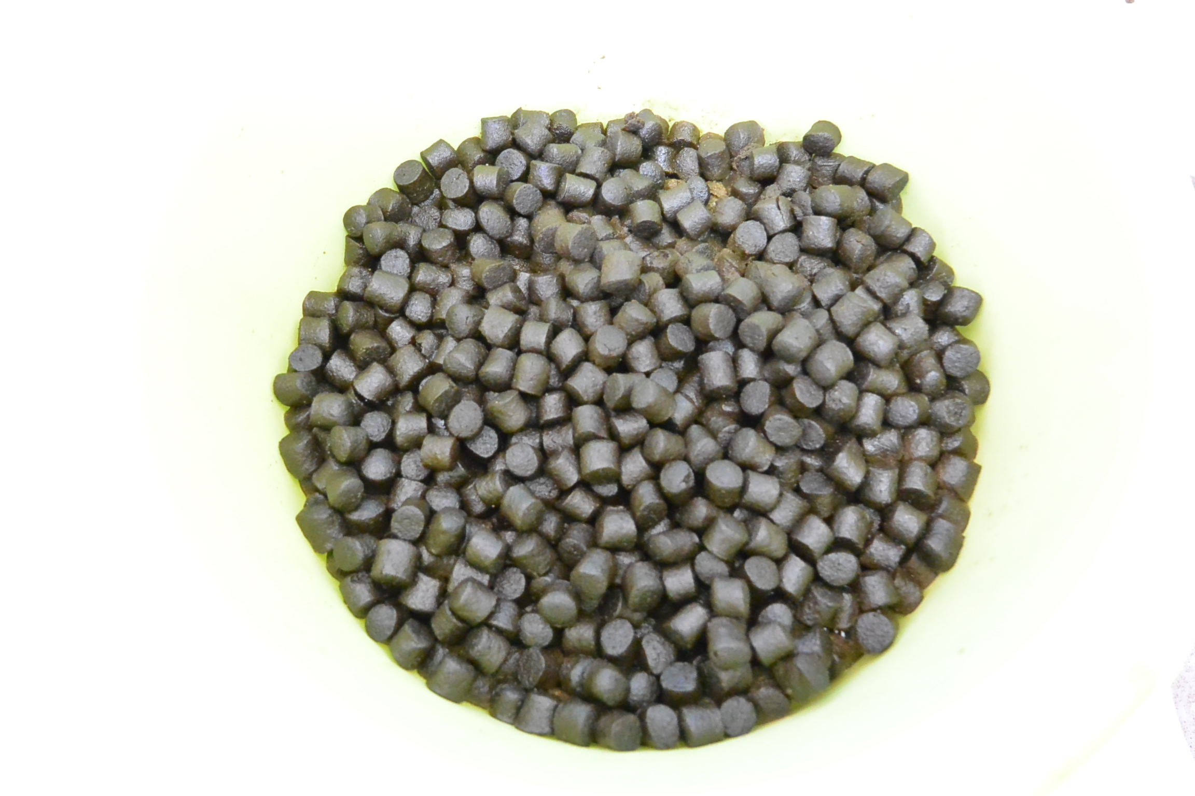
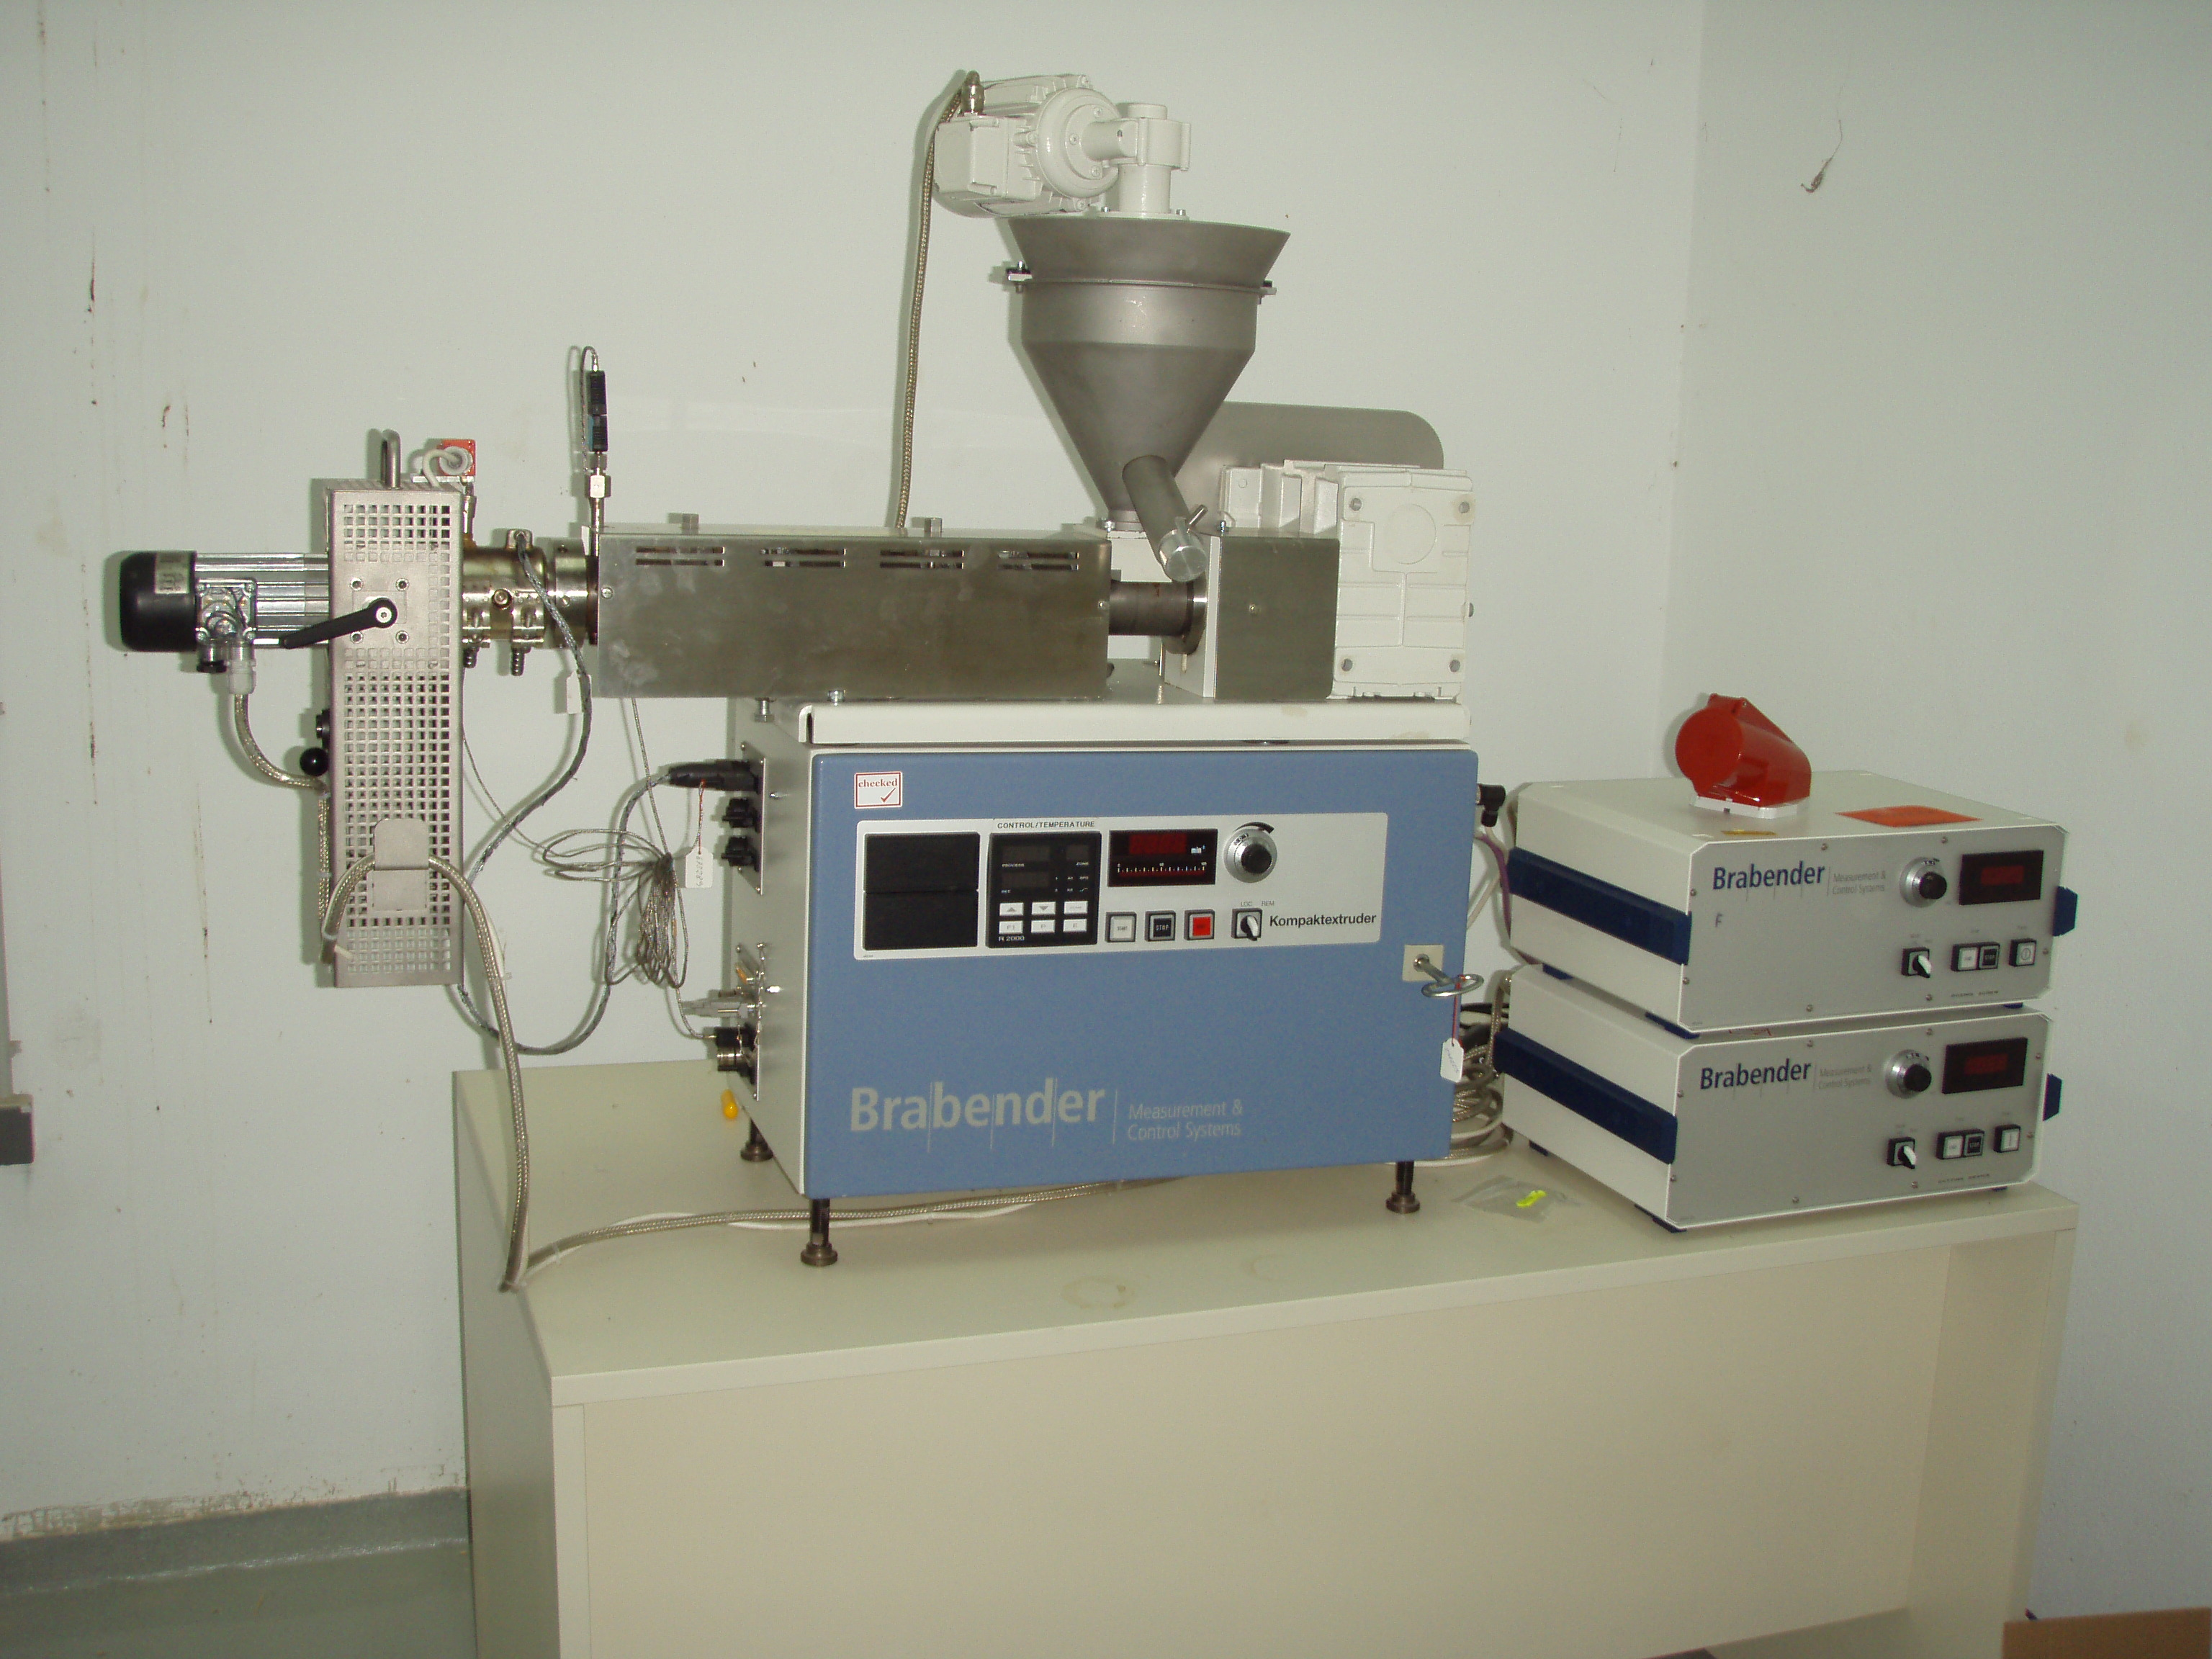
Scientific disciplines 2/6
Nutrition (12%)
  Live food enrichments products
  Larval diets
  Weaning, grow-out & broodstock diets

Slide 13
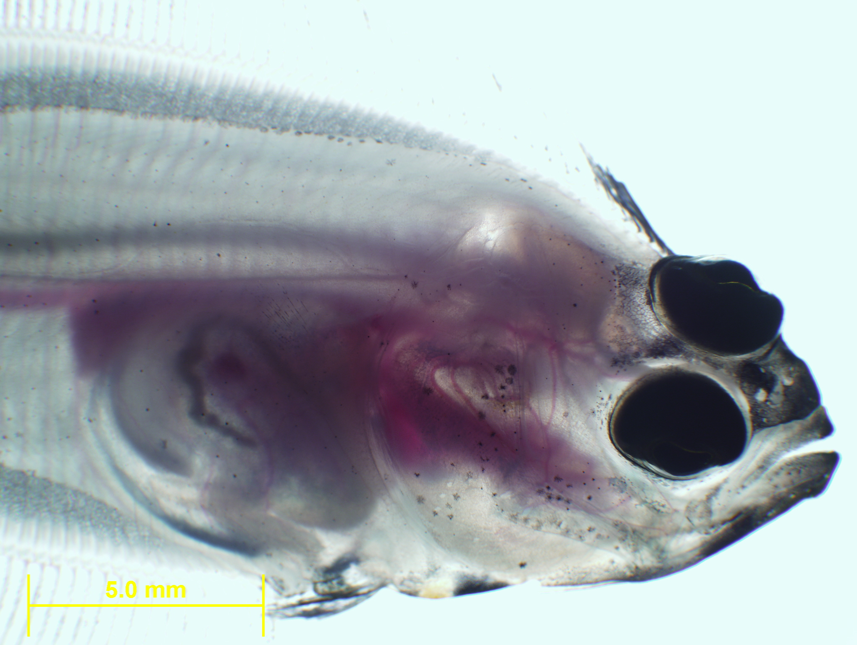
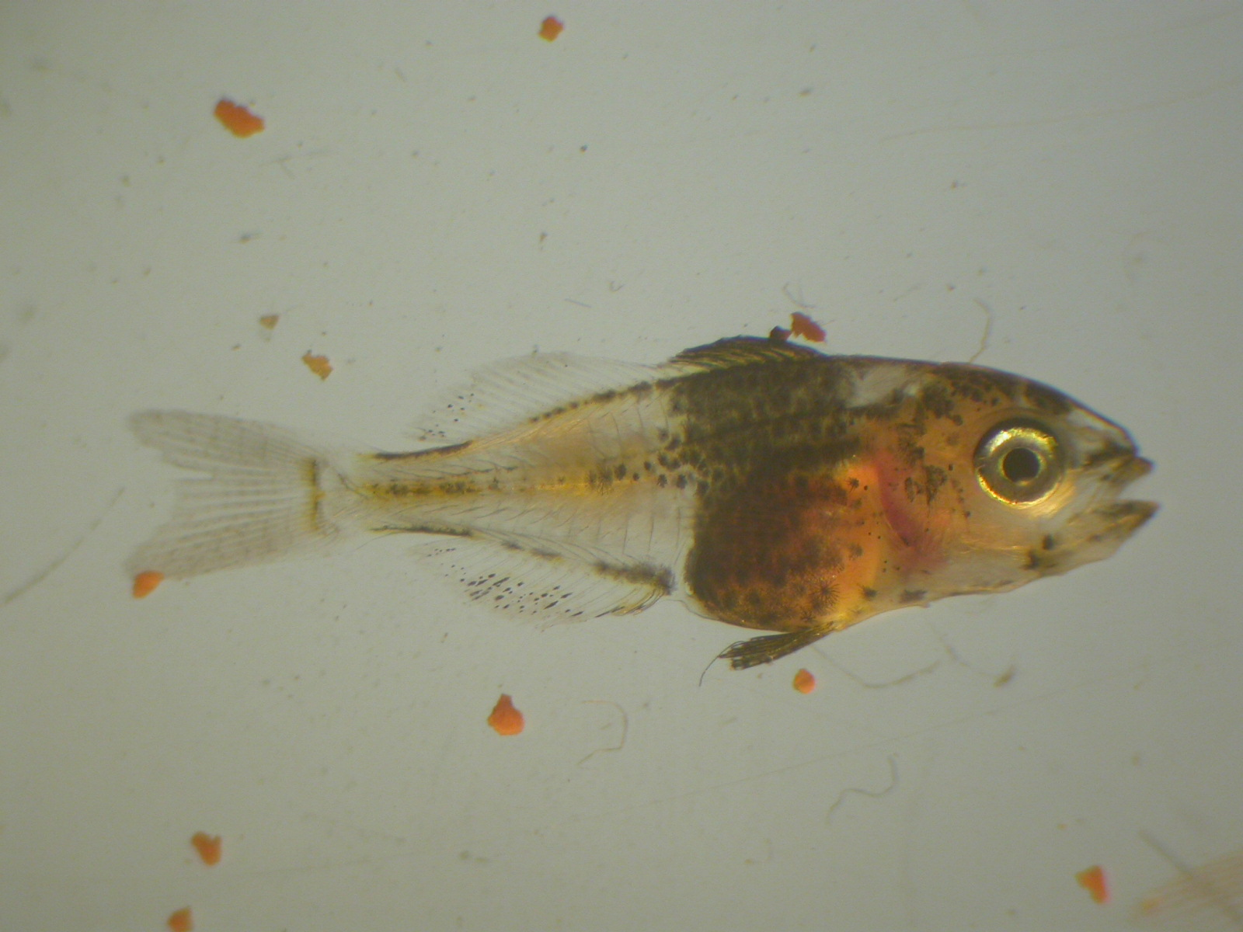
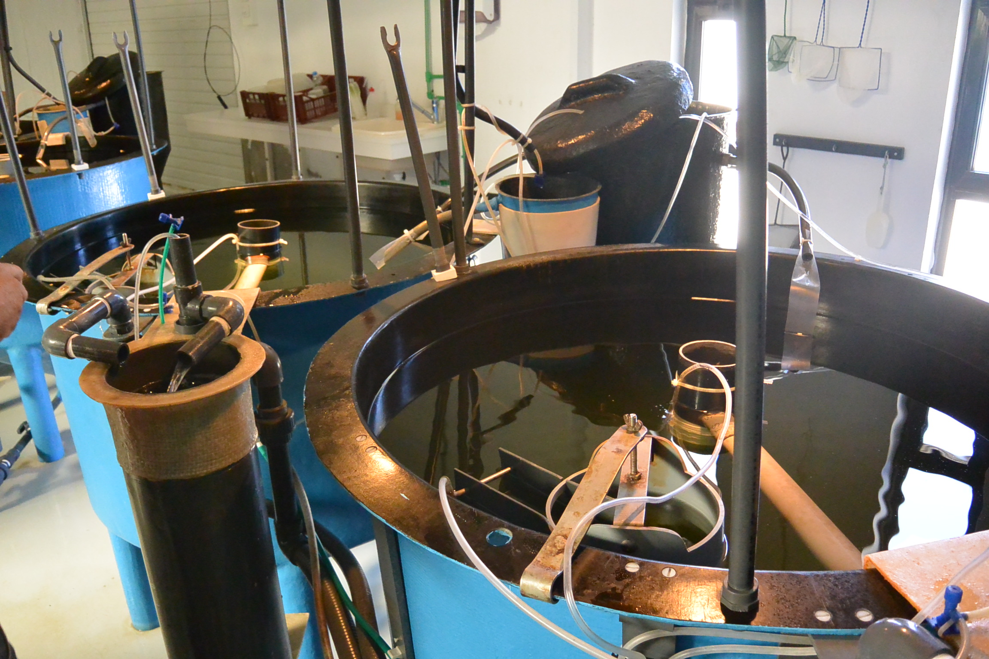
Scientific disciplines 3/6
Larval husbandry (16%)
  Rearing methods, early weaning, feeding strategies
  Cannibalism, enhanced survival & quality

Slide 14
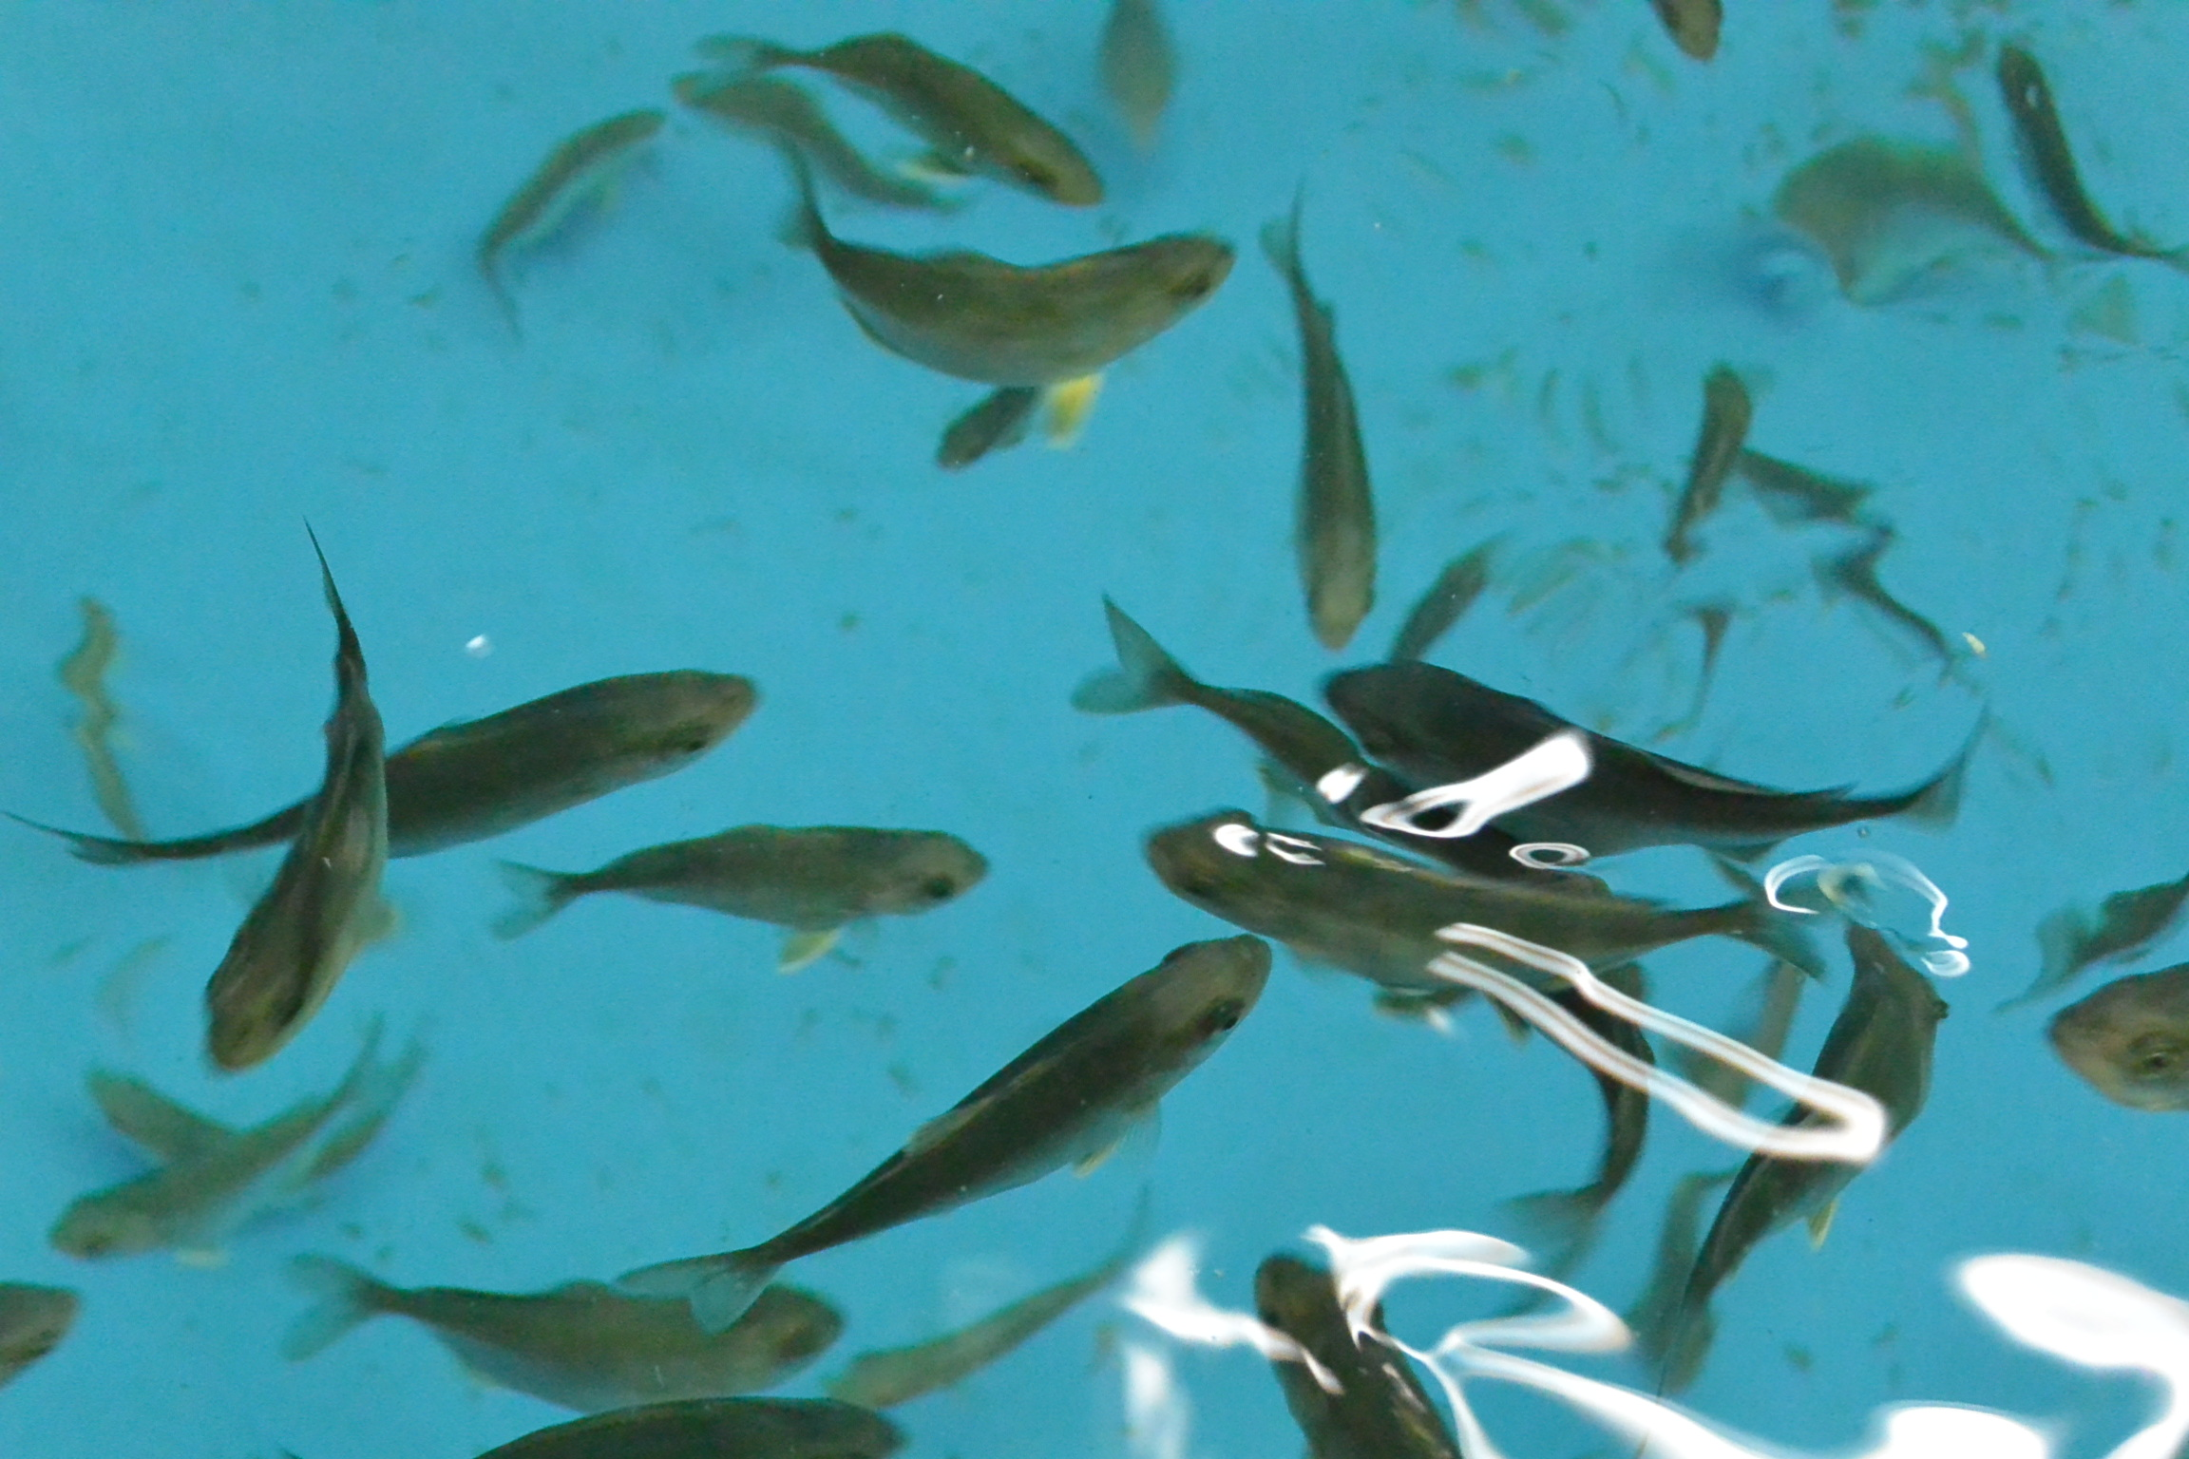
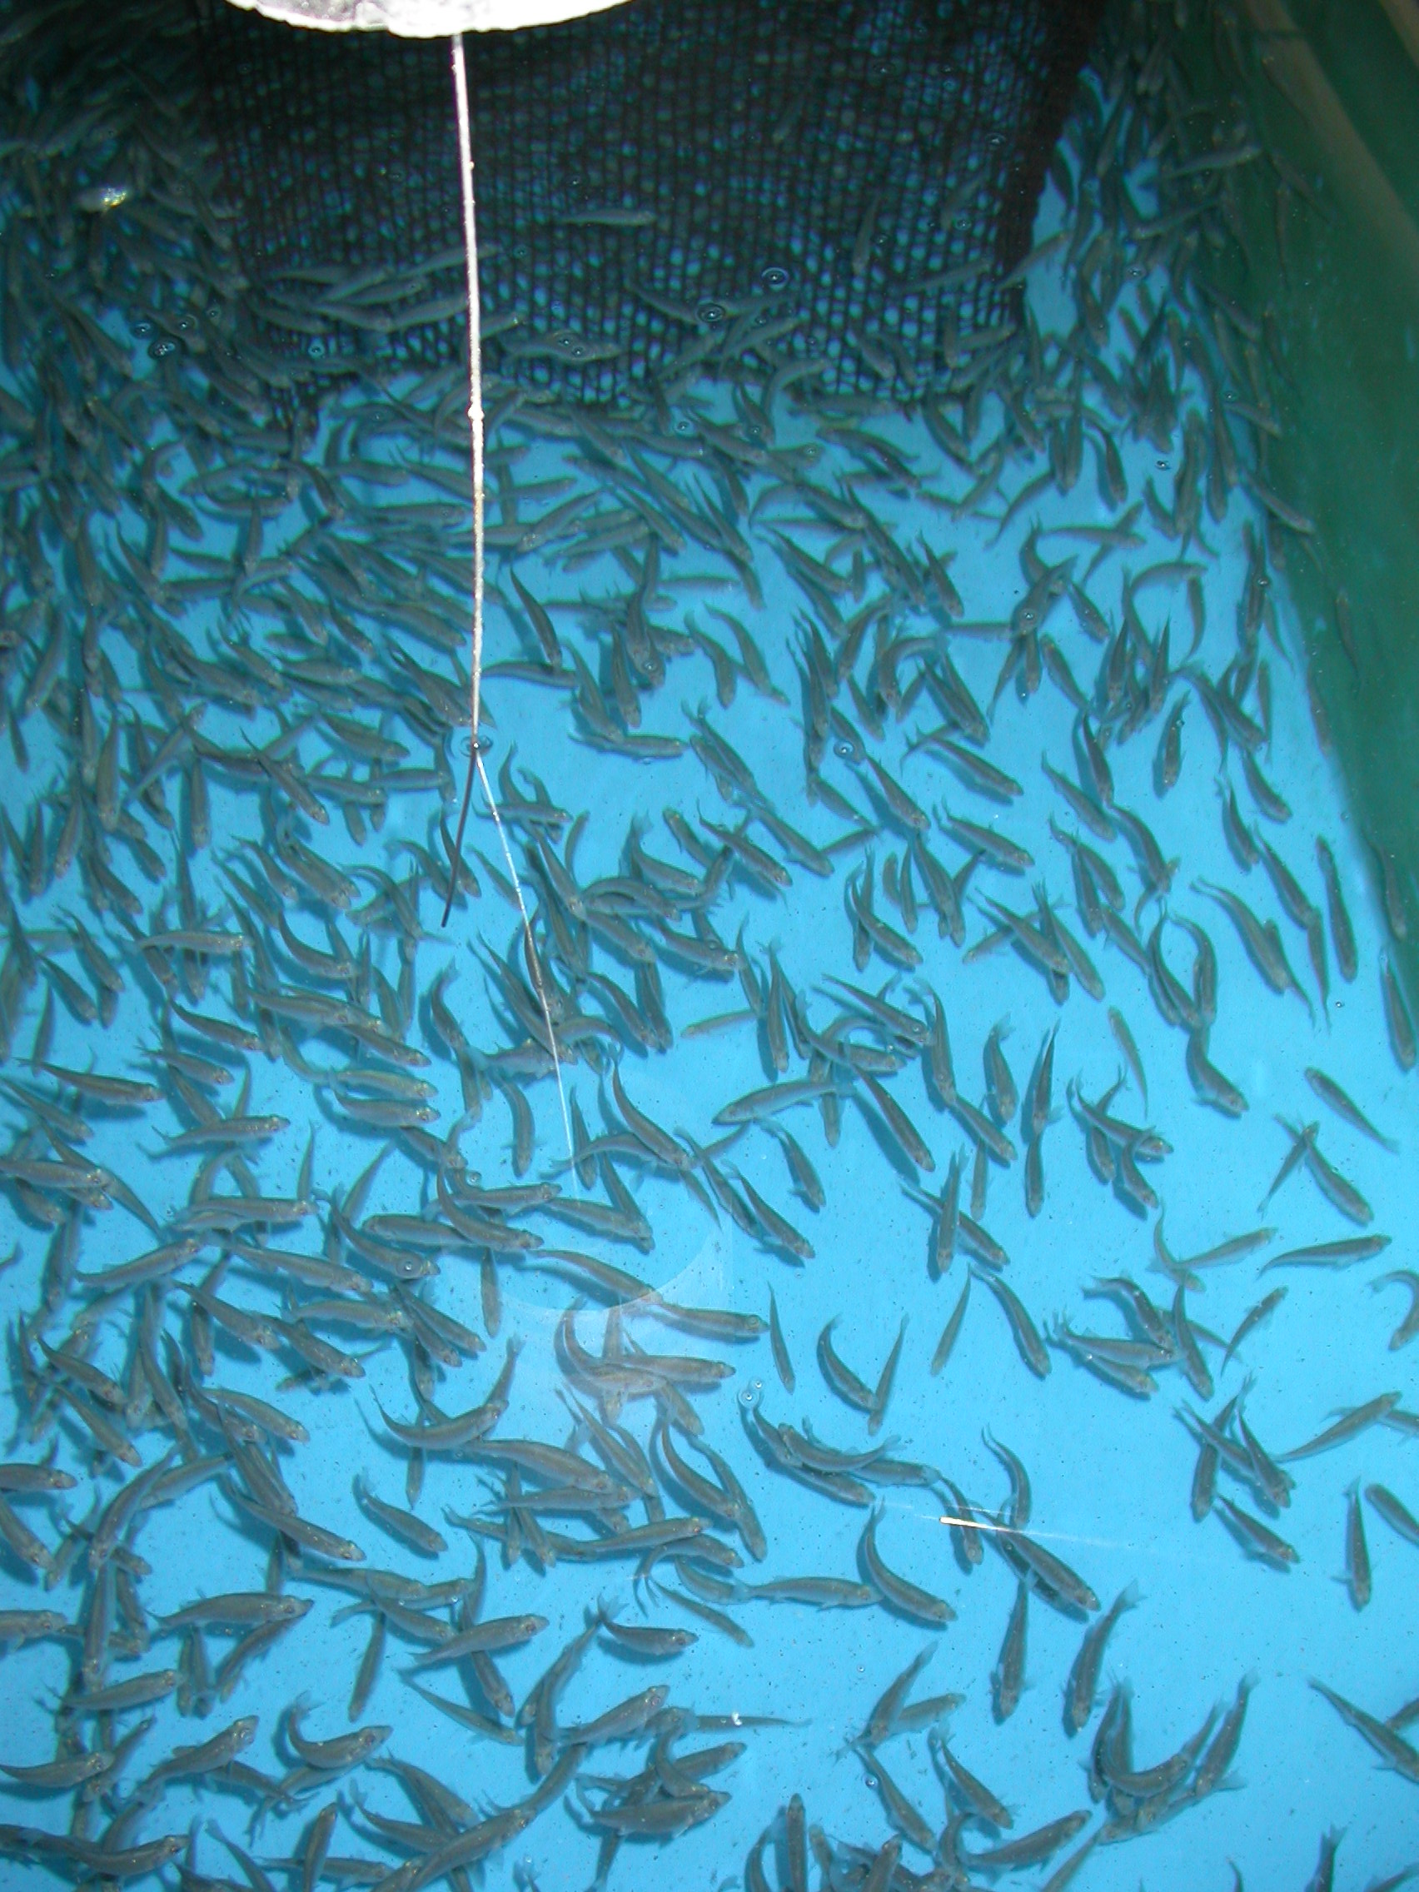
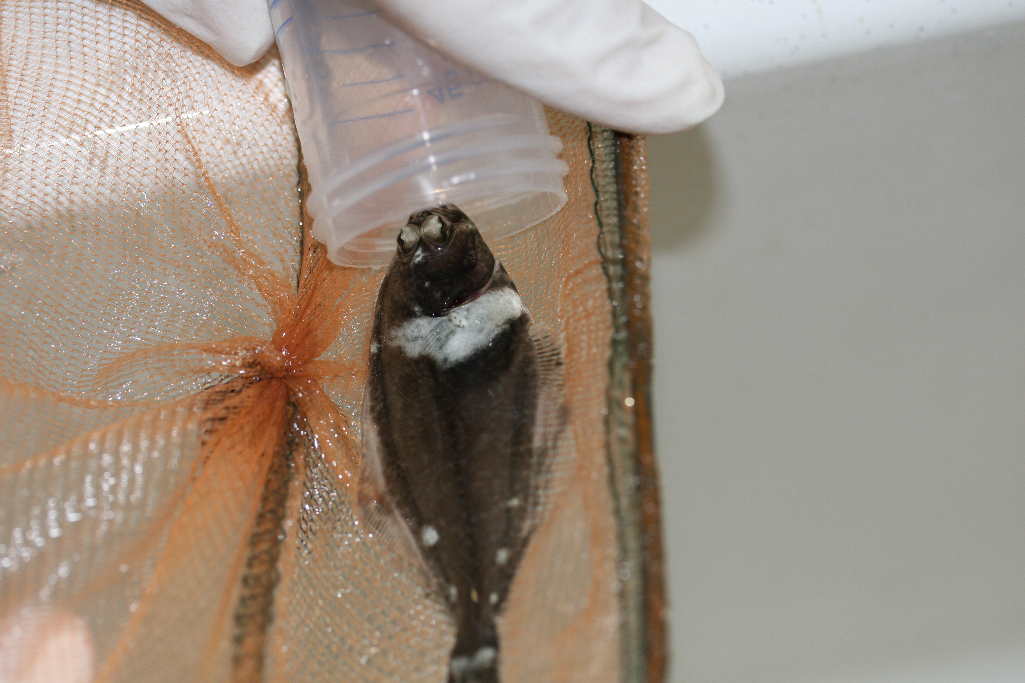
Scientific disciplines 4/6
Grow out husbandry (20%)
  Depth and density, cage type
  Feeding strategies, behaviour
  Rearing conditions in RAS

Slide 15
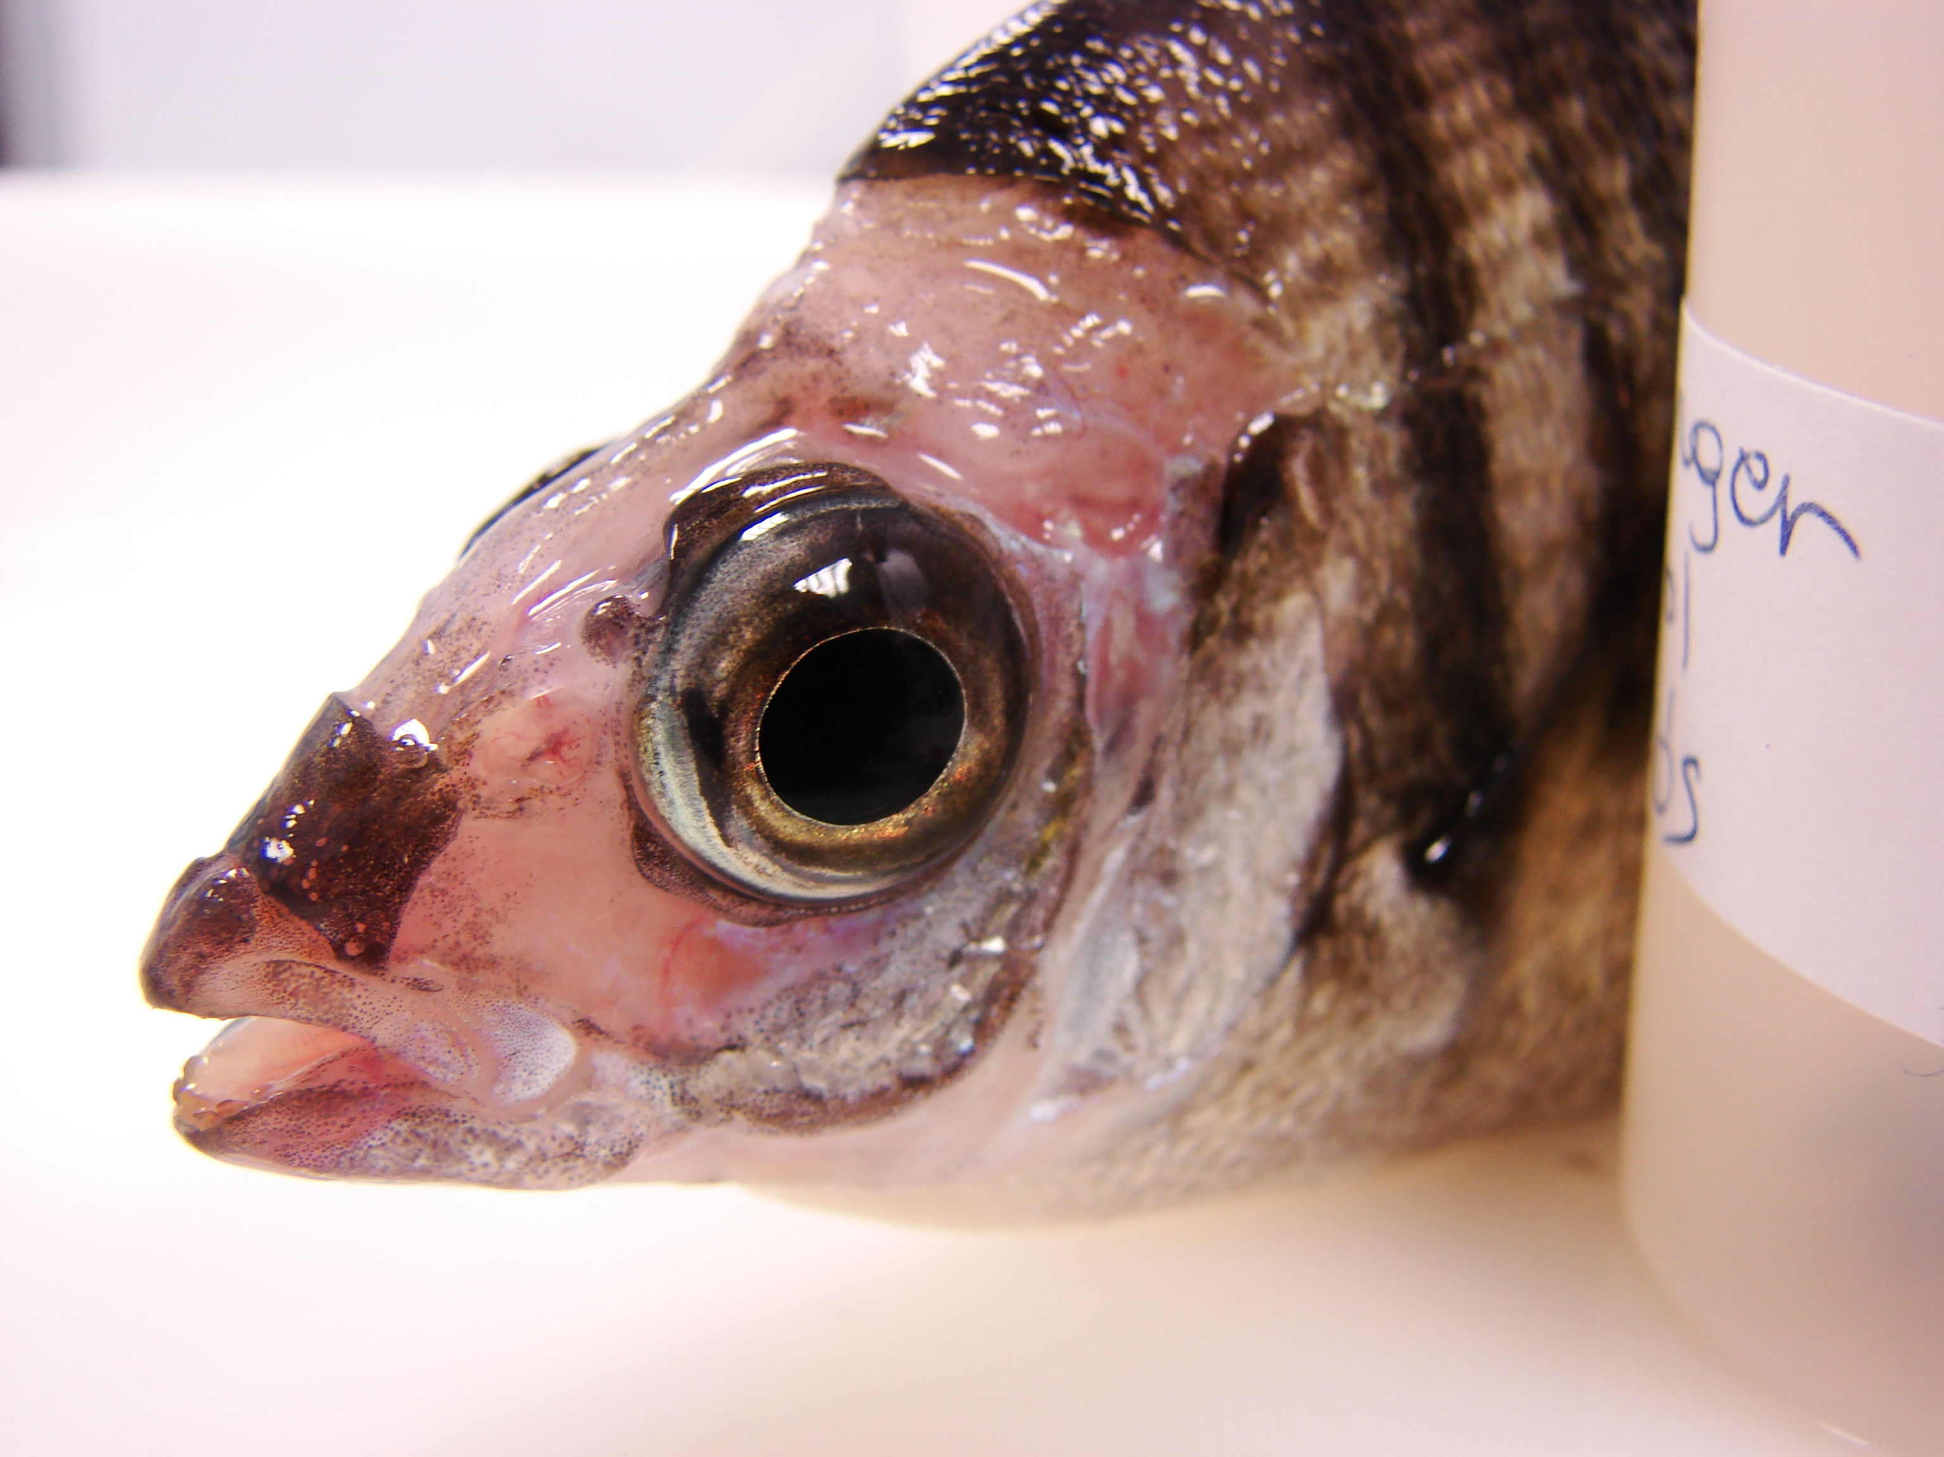
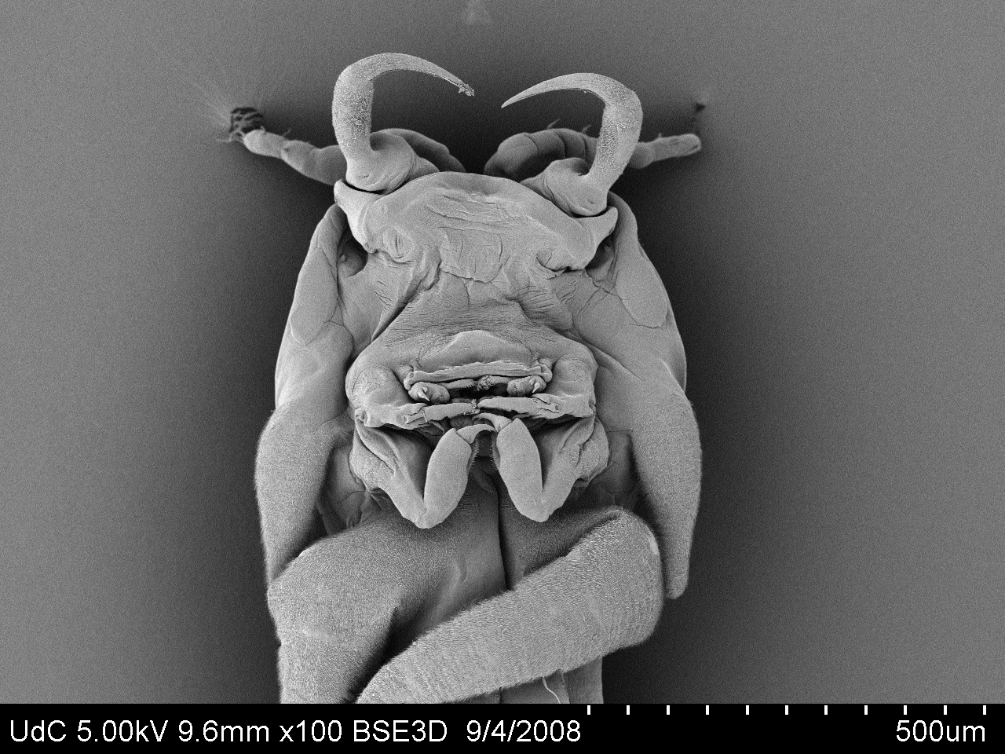
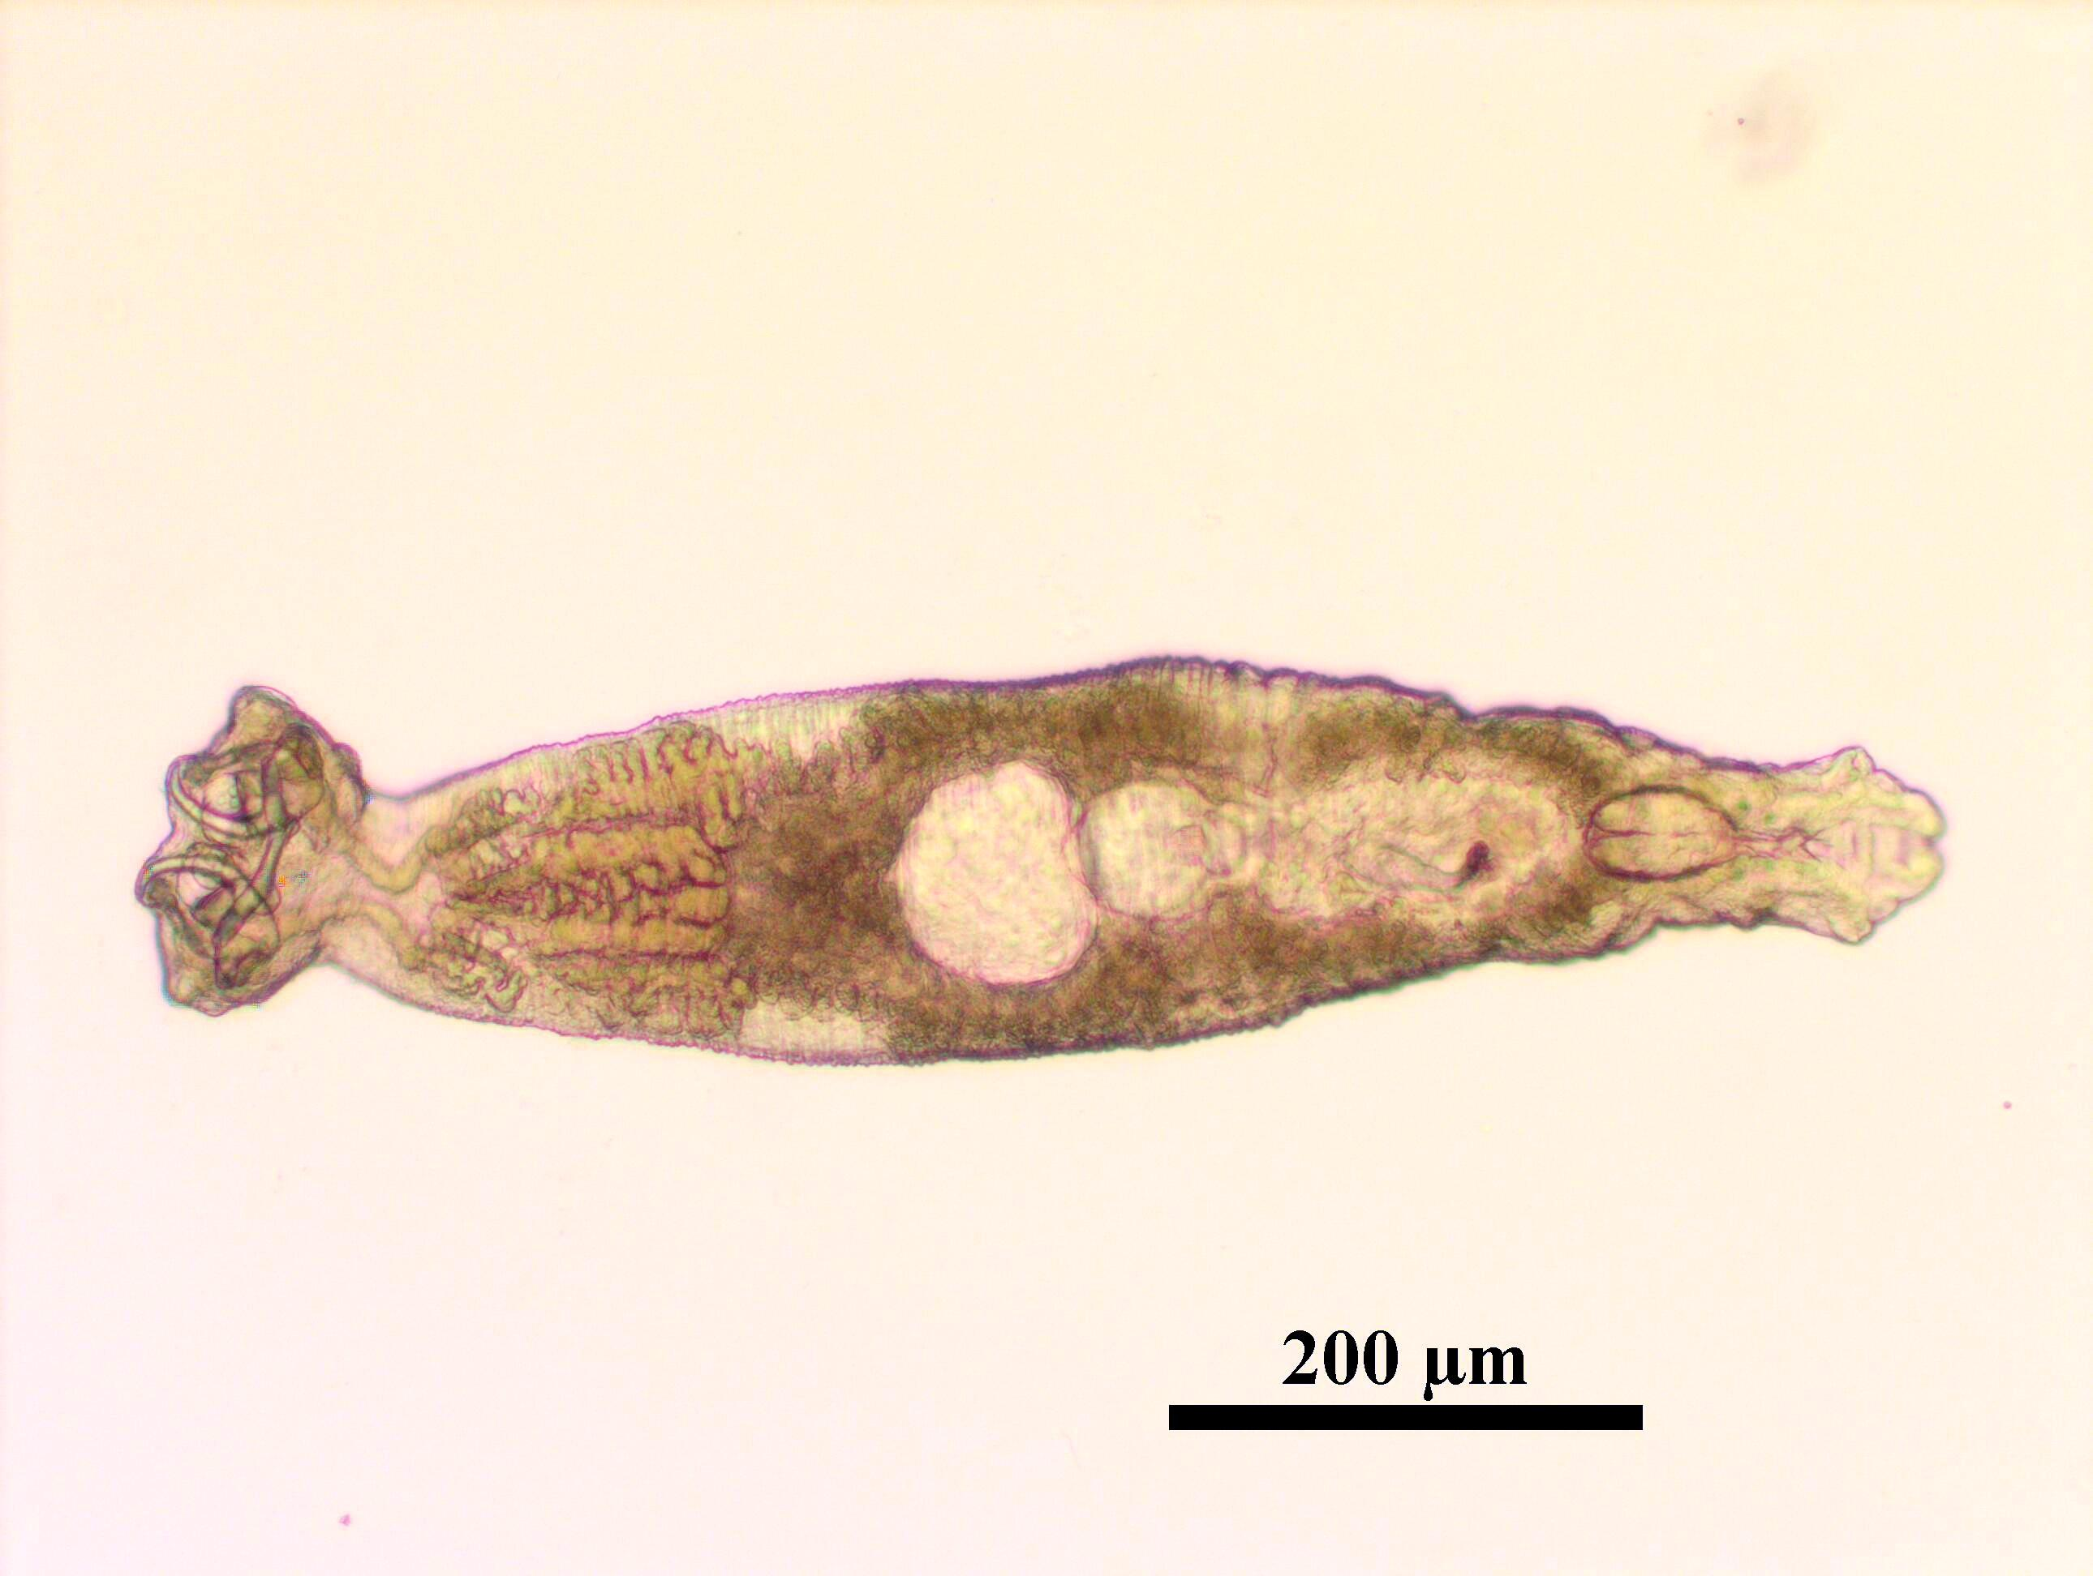
Scientific disciplines 5/6
Fish health (13%)
  Specific problems in certain species
  Immunology, vaccine development
  Diagnostic-prevention-treatment protocols

Slide 16
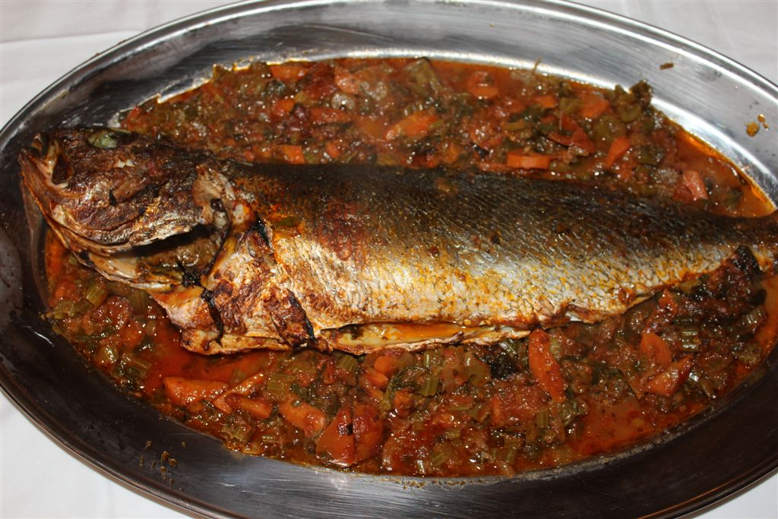
Scientific disciplines 6/6
Socio-economics (20%)
  perception of aquaculture products
  market demand, buyer preferences
  new product development, value adding
  market development

Slide 17
Dissemination of results – initial brochure

Slide 18
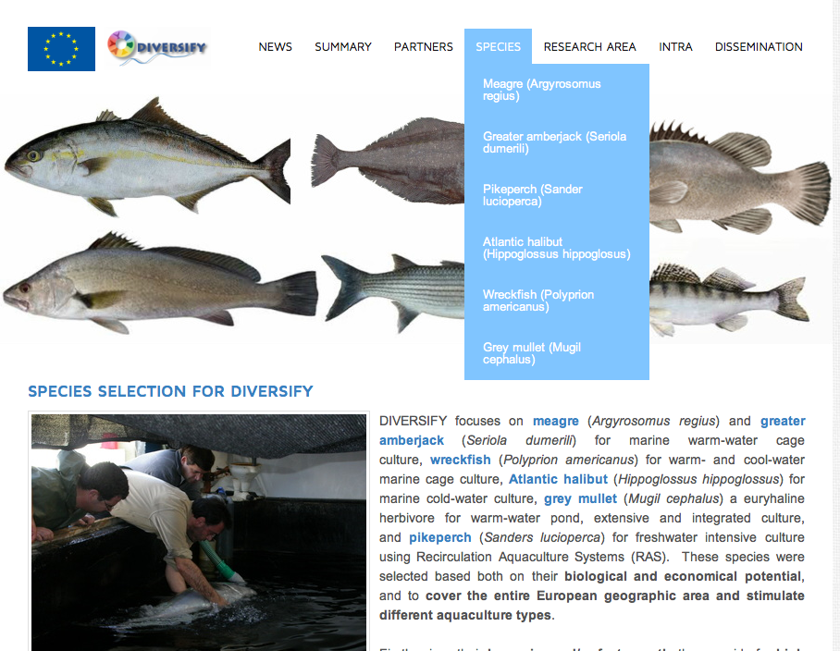
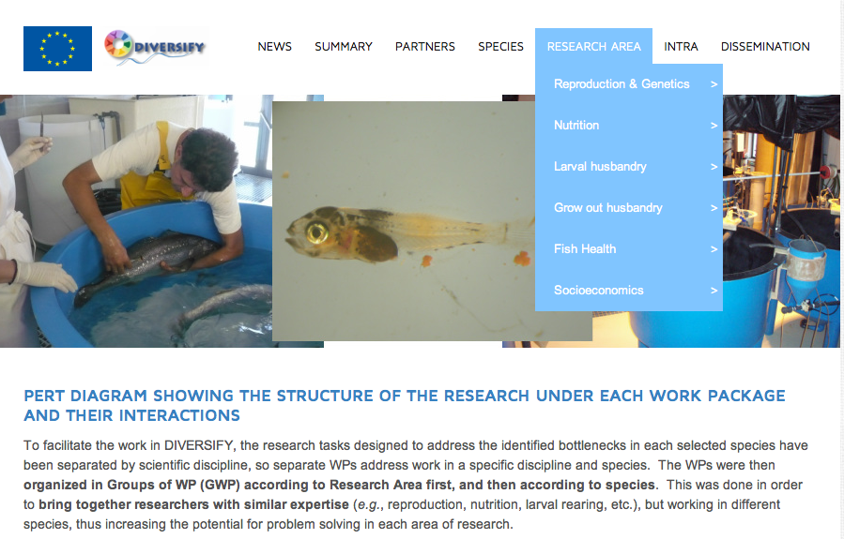
Dissemination – www.diversifyfish.eu

Slide 19
Diversification Session
Exploring the biological and socioeconomic potential of new/emerging candidate fish species for the expansion of the European aquaculture industry
Co-funded by the Seventh Framework Programme
of the European Union
Constantinos C Mylonas
Hellenic Center for Marine Research
Crete, Greece

